Slide 1

第8章 Intro to NLP
中山大学计算机学院
Adapted from slides by Christopher Manning

Slide 2
目录
第8章 Intro to NLP
1 Word2Vec
2 Seq2Seq Models
3 Transformers
4 LLMs

Slide 3
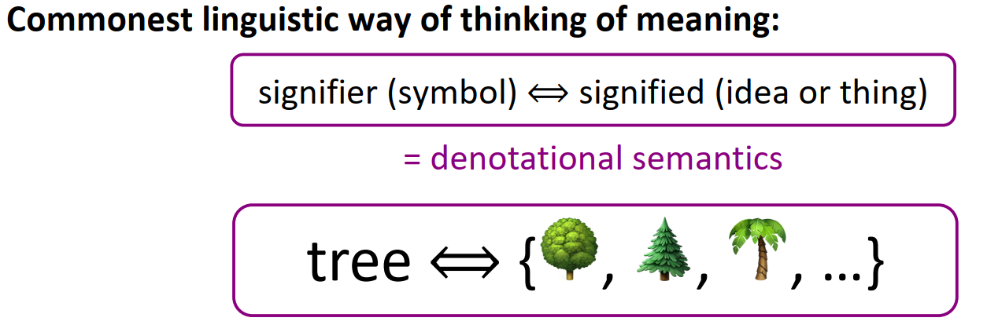
Word2Vec
How do we represent the meaning of a word? Definition: meaning (Webster dictionary) • the idea that is represented by a word, phrase, etc. • the idea that a person wants to express by using words, signs, etc. • the idea that is expressed in a work of writing, art, etc.

Slide 4
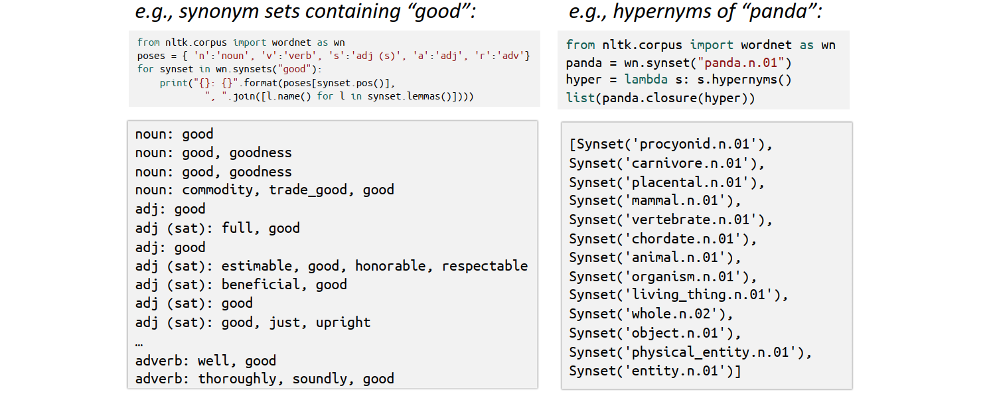
Word2Vec
How do we have usable meaning in a computer? Previously commonest NLP solution: Use, e.g., WordNet, a thesaurus containing lists of synonym sets and hypernyms (“is a” relationships)

Slide 5
Word2Vec
Problems with resources like WordNet • A useful resource but missing nuance: • e.g., “proficient” is listed as a synonym for “good” This is only correct in some contexts • Also, WordNet list offensive synonyms in some synonym sets without any coverage of the connotations or appropriateness of words • Missing new meanings of words: • e.g., wicked, badass, nifty, wizard, genius, ninja, bombest • Impossible to keep up-to-date! • Subjective • Requires human labor to create and adapt • Can’t be used to accurately compute word similarity (see following slides)

Slide 6
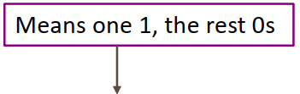
Word2Vec
Representing words as discrete symbols In traditional NLP, we regard words as discrete symbols: hotel, conference, motel – a localist representation
Such symbols for words can be represented by one-hot vectors: motel = [0 0 0 0 0 0 0 0 0 0 1 0 0 0 0] hotel = [0 0 0 0 0 0 0 1 0 0 0 0 0 0 0]
Vector dimension = number of words in vocabulary (e.g., 500,000+)

Slide 7
Word2Vec
Problem with words as discrete symbols Example: in web search, if a user searches for “Seattle motel”, we would like to match documents containing “Seattle hotel”
But: motel = [0 0 0 0 0 0 0 0 0 0 1 0 0 0 0] hotel = [0 0 0 0 0 0 0 1 0 0 0 0 0 0 0] These two vectors are orthogonal There is no natural notion of similarity for one-hot vectors!
Solution: • Could try to rely on WordNet’s list of synonyms to get similarity? • But it is well-known to fail badly: incompleteness, etc. • Instead: learn to encode similarity in the vectors themselves

Slide 8
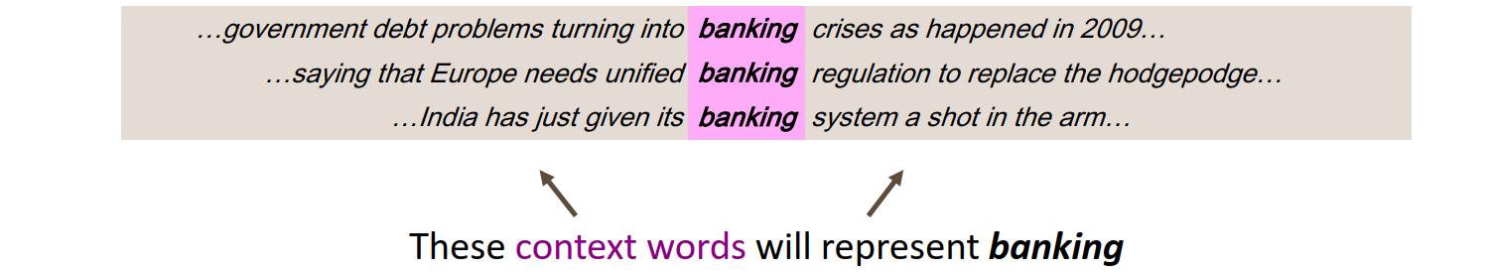
Word2Vec
Representing words by their context
• Distributional semantics: A word’s meaning is given by the words that frequently appear close-by • “You shall know a word by the company it keeps” (J. R. Firth 1957: 11) • One of the most successful ideas of modern statistical NLP! • When a word w appears in a text, its context is the set of words that appear nearby (within a fixed-size window). • We use the many contexts of w to build up a representation of w

Slide 9
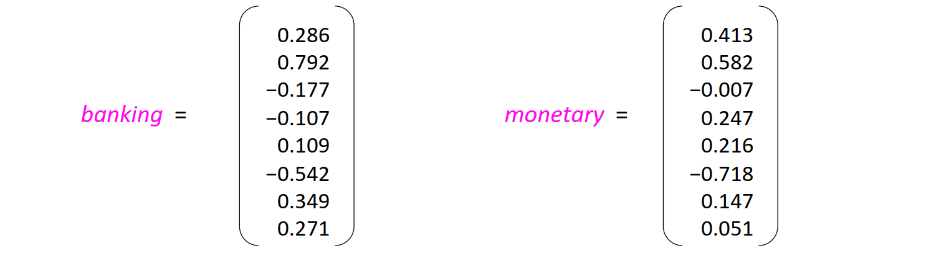
Word2Vec
Word vectors We will build a dense vector for each word, chosen so that it is similar to vectors of words that appear in similar contexts, measuring similarity as the vector dot (scalar) product
Note: word vectors are also called (word) embeddings or (neural) word representations They are a distributed representation

Slide 10
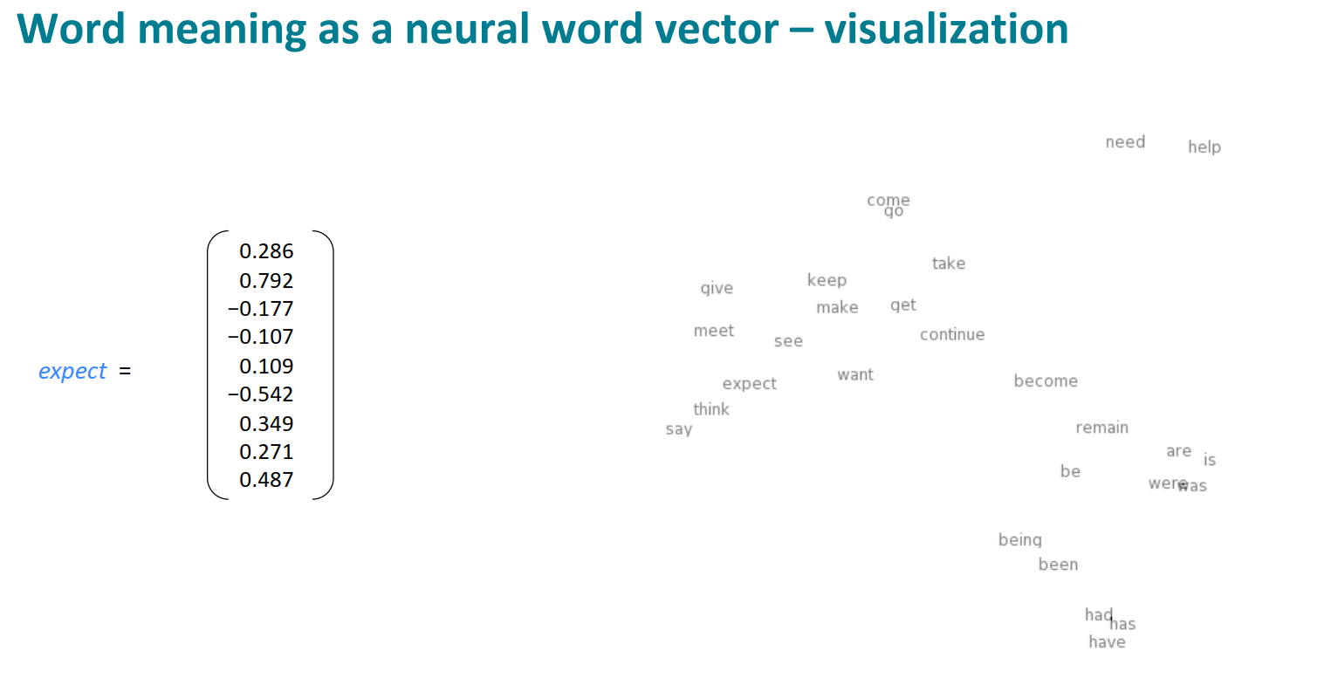
Word2Vec

Slide 11
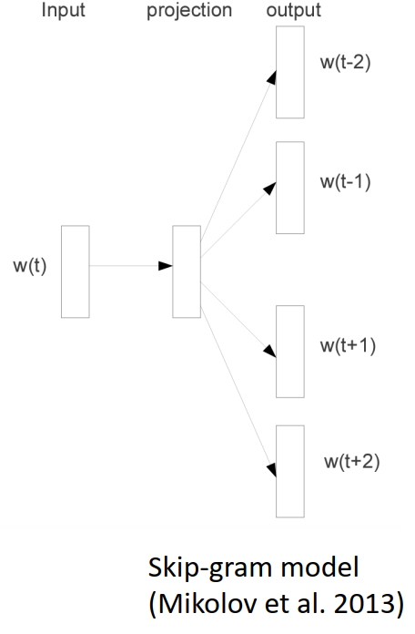
Word2Vec
Word2vec: Overview
Word2vec is a framework for learning word vectors (Mikolov et al. 2013)
Idea: • We have a large corpus (“body”) of text: a long list of words • Every word in a fixed vocabulary is represented by a vector • Go through each position t in the text, which has a center word c and context (“outside”) words o • Use the similarity of the word vectors for c and o to calculate the probability of o given c (or vice versa) • Keep adjusting the word vectors to maximize this probability
[Mikolov et al. 2013: “Distributed Representations of Words and Phrases and their Compositionality”]

Slide 12
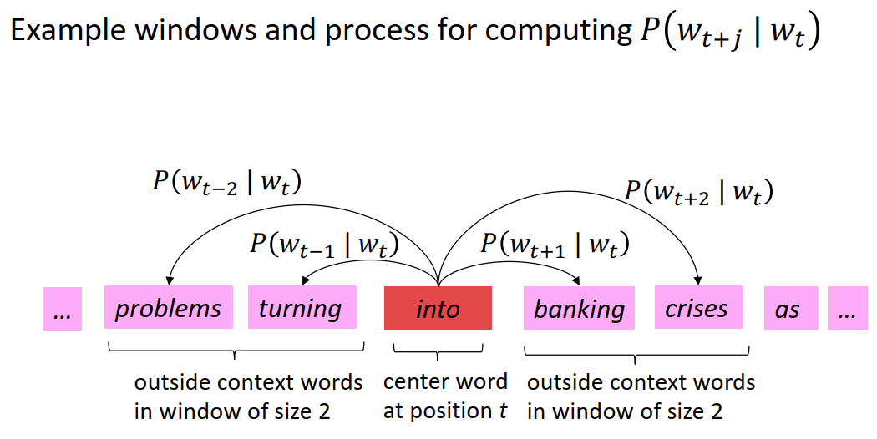
Word2Vec

Slide 13
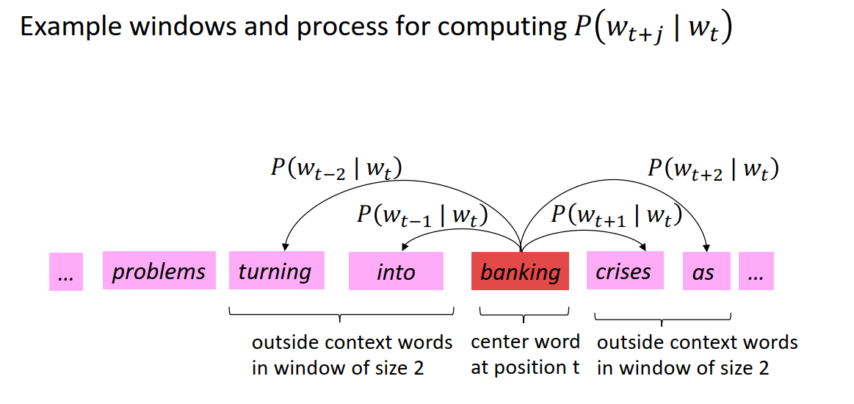
Word2Vec

Slide 14
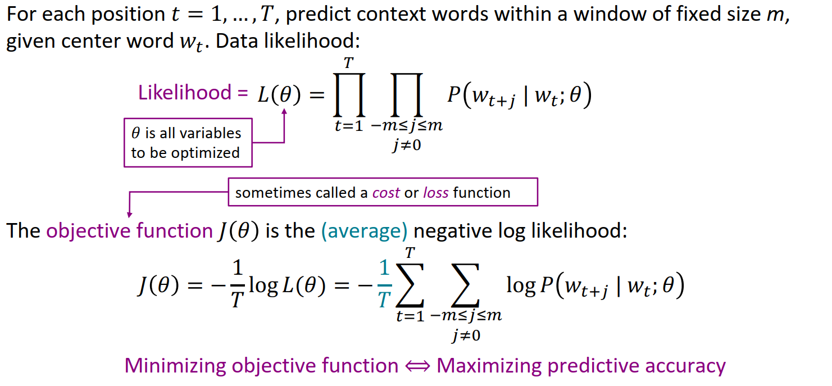
Word2Vec
Word2vec: objective function

Slide 15
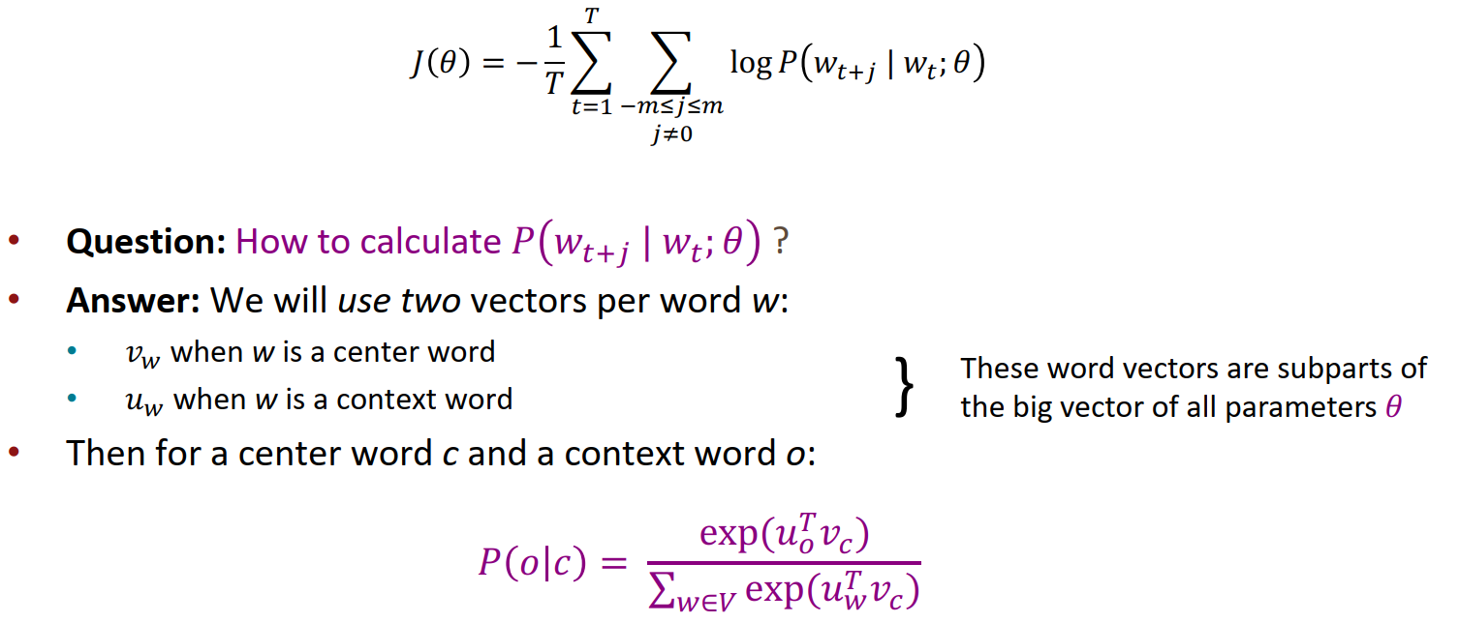
Word2Vec
Word2vec: objective function • We want to minimize the objective function:

Slide 16
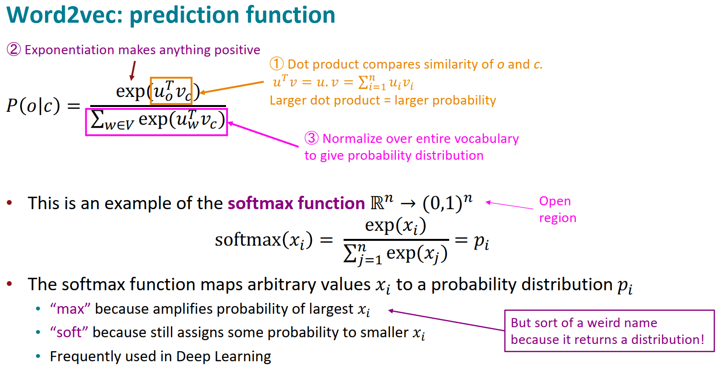
Word2Vec

Slide 17
Word2Vec
Word2vec algorithm family: More details
Why two vectors? à Easier optimization. Average both at the end • But can implement the algorithm with just one vector per word … and it helps a bit
Two model variants: 1. Skip-grams (SG) Predict context (“outside”) words (position independent) given center word 2. Continuous Bag of Words (CBOW) Predict center word from (bag of) context words We presented: Skip-gram model
Loss functions for training: 1. Naïve softmax (simple but expensive loss function, when many output classes) 2. More optimized variants like hierarchical softmax 3. Negative sampling So far, we explained naïve softmax

Slide 18
Word2Vec
• Language Model: A system that predicts the next word
• Recurrent Neural Network: A family of neural networks that: • Take sequential input of any length; apply the same weights on each step • Can optionally produce output on each step
• Recurrent Neural Network ≠ Language Model • RNNs can be used for many other things (see later)
• Language Modeling is a traditional subcomponent of many NLP tasks, all those involving generating text or estimating the probability of text: • Now everything in NLP is being rebuilt upon Language Modeling: GPT-3 is an LM! • Language modeling can be done with different models, e.g., n-grams or transformers

Slide 19
目录
第8章 Intro to NLP
1 Word2Vec
2 Seq2Seq Models
3 Transformers
4 LLMs

Slide 20
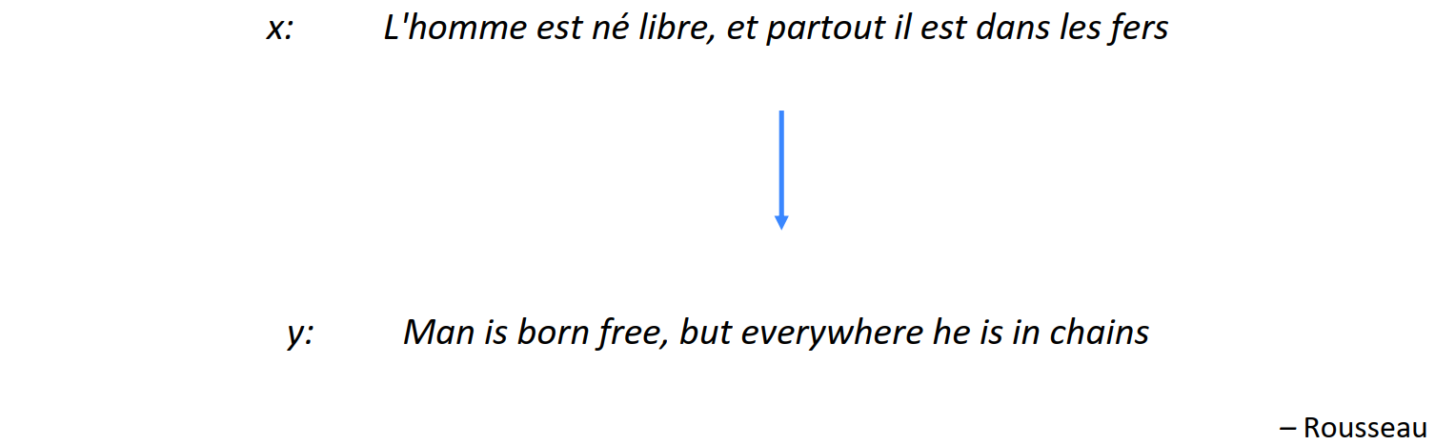
Seq2Seq Models
Machine Translation
Machine Translation (MT) is the task of translating a sentence x from one language (the source language) to a sentence y in another language (the target language).

Slide 21
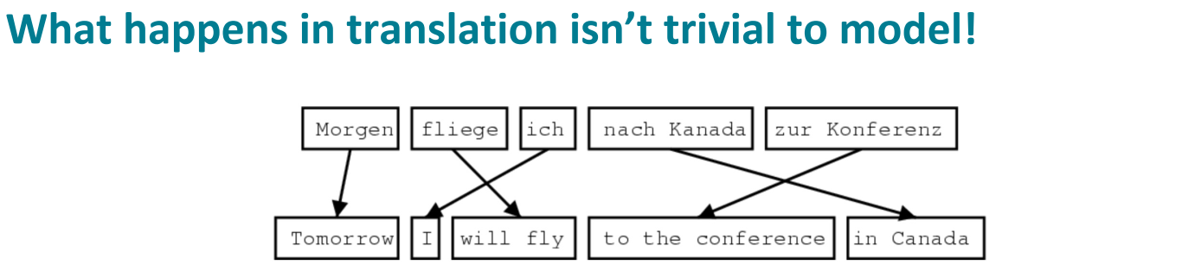
Seq2Seq Models
1519年600名西班牙人在墨西哥登陆，去征服几百万人口 的阿兹特克帝国，初次交锋他们损兵三分之二。 In 1519, six hundred Spaniards landed in Mexico to conquer the Aztec Empire with a population of a few million. They lost two thirds of their soldiers in the first clash.
translate.google.com (2009): 1519 600 Spaniards landed in Mexico, millions of people to conquer the Aztec empire, the first two-thirds of soldiers against their loss. translate.google.com (2013): 1519 600 Spaniards landed in Mexico to conquer the Aztec empire, hundreds of millions of people, the initial confrontation loss of soldiers two-thirds. translate.google.com (2015): 1519 600 Spaniards landed in Mexico, millions of people to conquer the Aztec empire, the first two-thirds of the loss of soldiers they clash.

Slide 22
Seq2Seq Models
1990s–2010s: Statistical Machine Translation
• SMT was a huge research field
• The best systems were extremely complex • Hundreds of important details
• Systems had many separately-designed subcomponents • Lots of feature engineering • Need to design features to capture particular language phenomena • Required compiling and maintaining extra resources • Like tables of equivalent phrases • Lots of human effort to maintain • Repeated effort for each language pair!

Slide 23
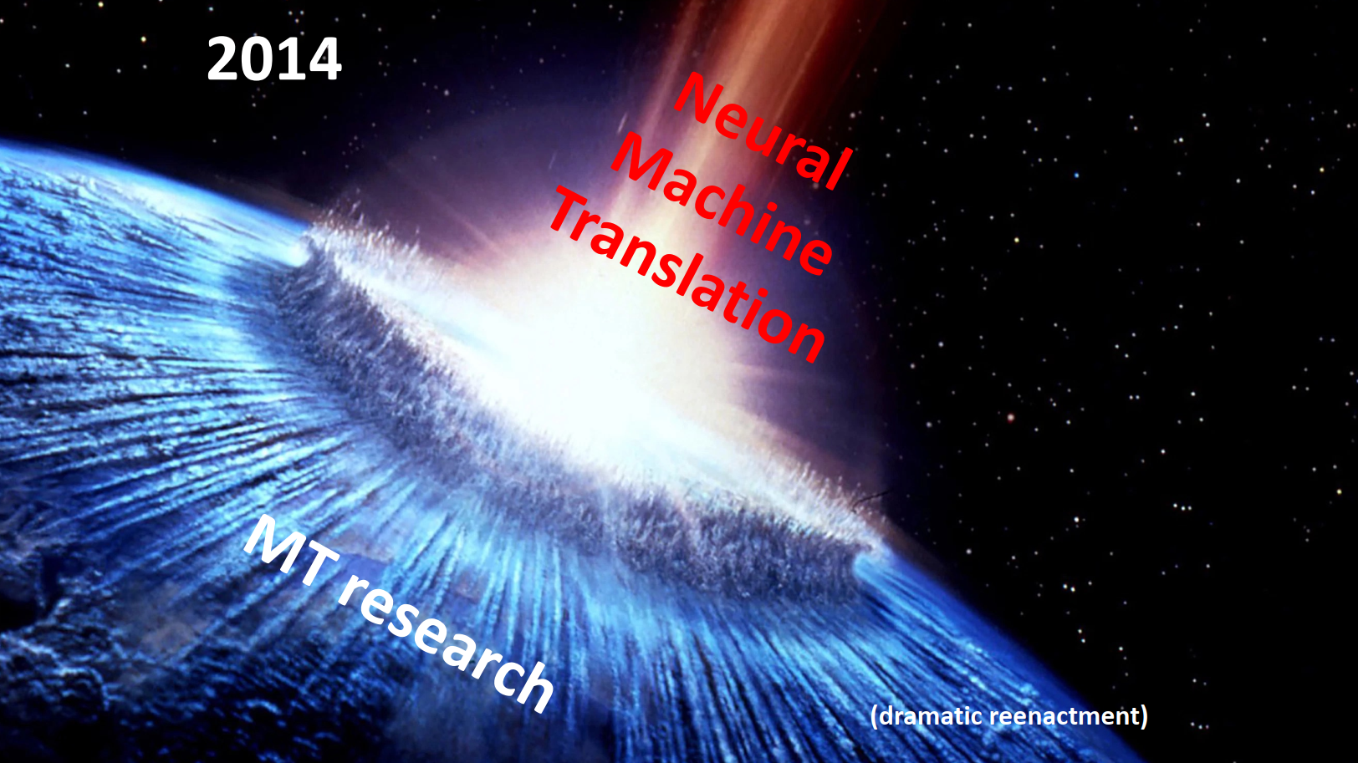
Seq2Seq Models

Slide 24
Seq2Seq Models
What is Neural Machine Translation?
• Neural Machine Translation (NMT) is a way to do Machine Translation with a single end-to-end neural network
• The neural network architecture is called a sequence-to-sequence model (aka seq2seq) and it involves two RNNs

Slide 25
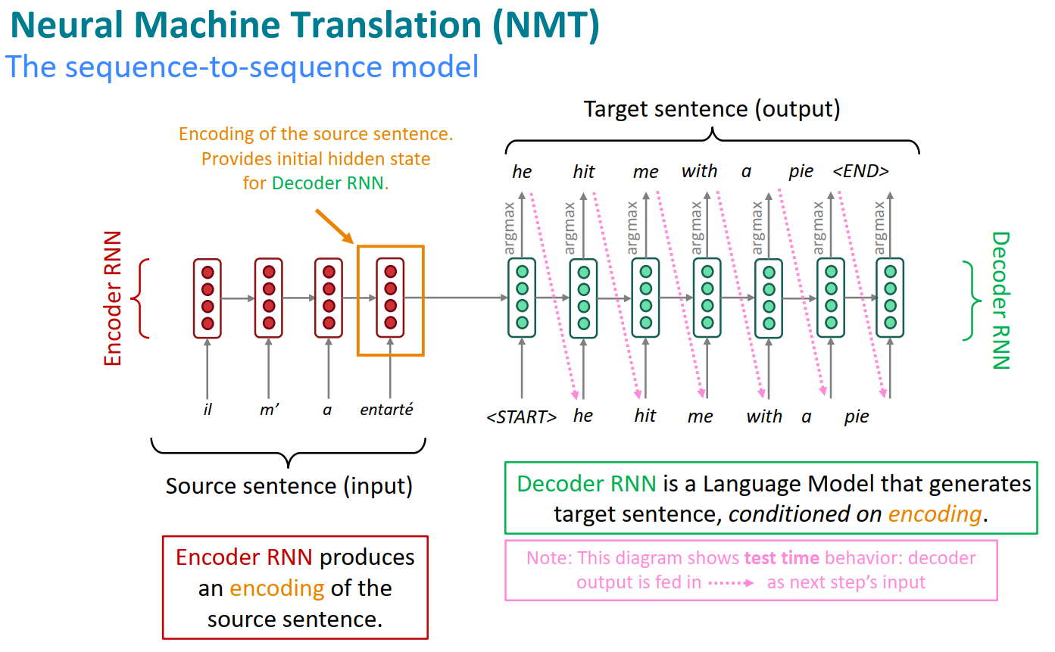
Seq2Seq Models

Slide 26
Seq2Seq Models
Sequence-to-sequence is versatile!
• The general notion here is an encoder-decoder model • One neural network takes input and produces a neural representation • Another network produces output based on that neural representation • If the input and output are sequences, we call it a seq2seq model
• Sequence-to-sequence is useful for more than just MT • Many NLP tasks can be phrased as sequence-to-sequence: • Summarization (long text → short text) • Dialogue (previous utterances → next utterance) • Parsing (input text → output parse as sequence) • Code generation (natural language → Python code)

Slide 27
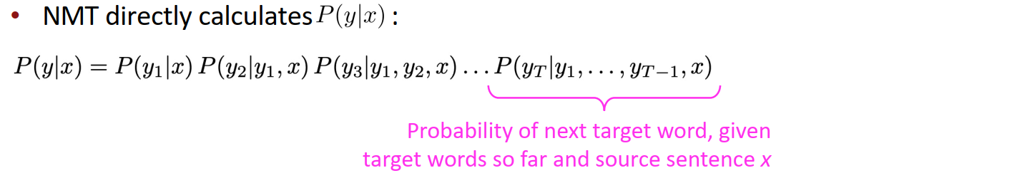
Seq2Seq Models
Neural Machine Translation (NMT)
• The sequence-to-sequence model is an example of a Conditional Language Model • Language Model because the decoder is predicting the next word of the target sentence y • Conditional because its predictions are also conditioned on the source sentence x
• Question: How to train an NMT system? • (Easy) Answer: Get a big parallel corpus… • But there is now exciting work on “unsupervised NMT”, data augmentation, etc.

Slide 28
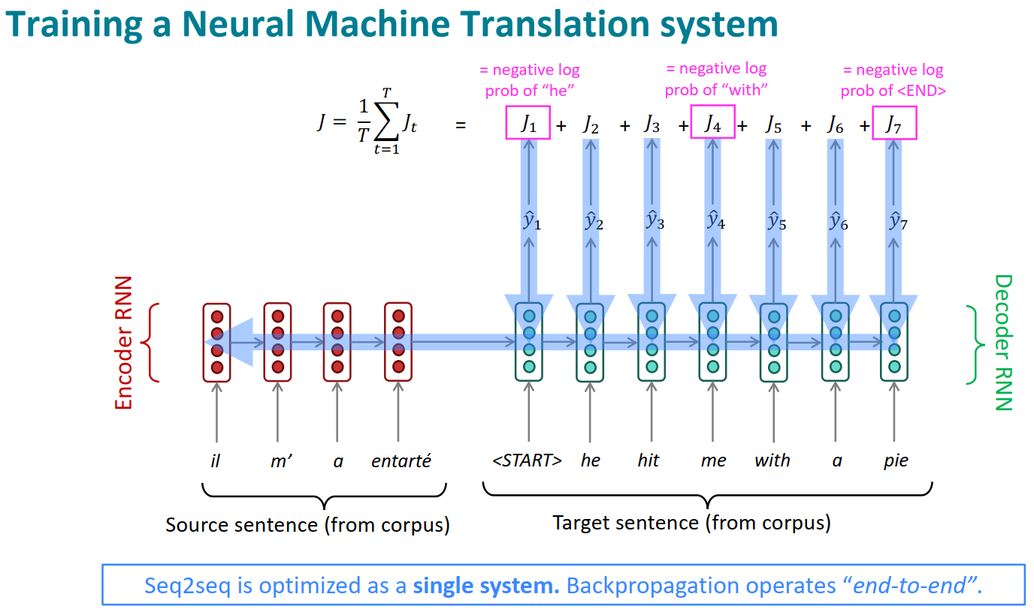
Seq2Seq Models

Slide 29
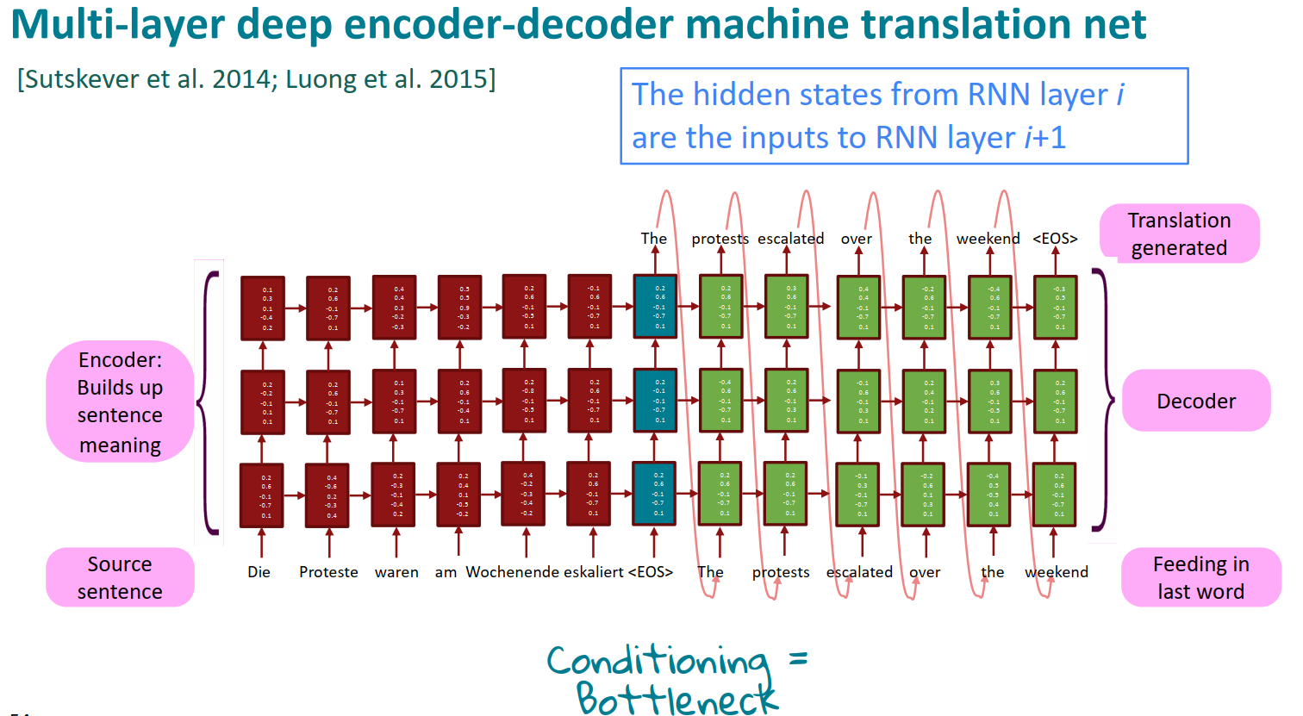
Seq2Seq Models

Slide 30
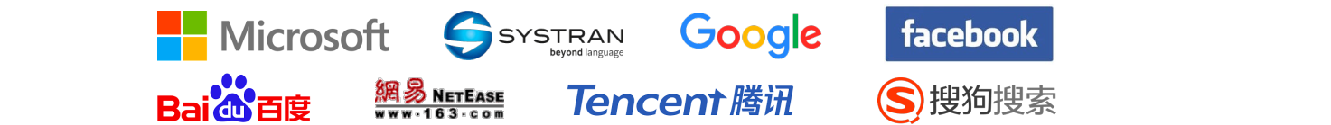
Seq2Seq Models
NMT: the first big success story of NLP Deep Learning Neural Machine Translation went from a fringe research attempt in 2014 to the leading standard method in 2016
• 2014: First seq2seq paper published [Sutskever et al. 2014] • 2016: Google Translate switches from SMT to NMT – and by 2018 everyone had • https://www.nytimes.com/2016/12/14/magazine/the-great-ai-awakening.html
• This was amazing! • SMT systems, built by hundreds of engineers over many years, were outperformed by NMT systems trained by small groups of engineers in a few months

Slide 31
目录
第xxx章 Intro to NLP
1 Word2Vec
2 Seq2Seq Models
3 Transformers
4 LLMs

Slide 32
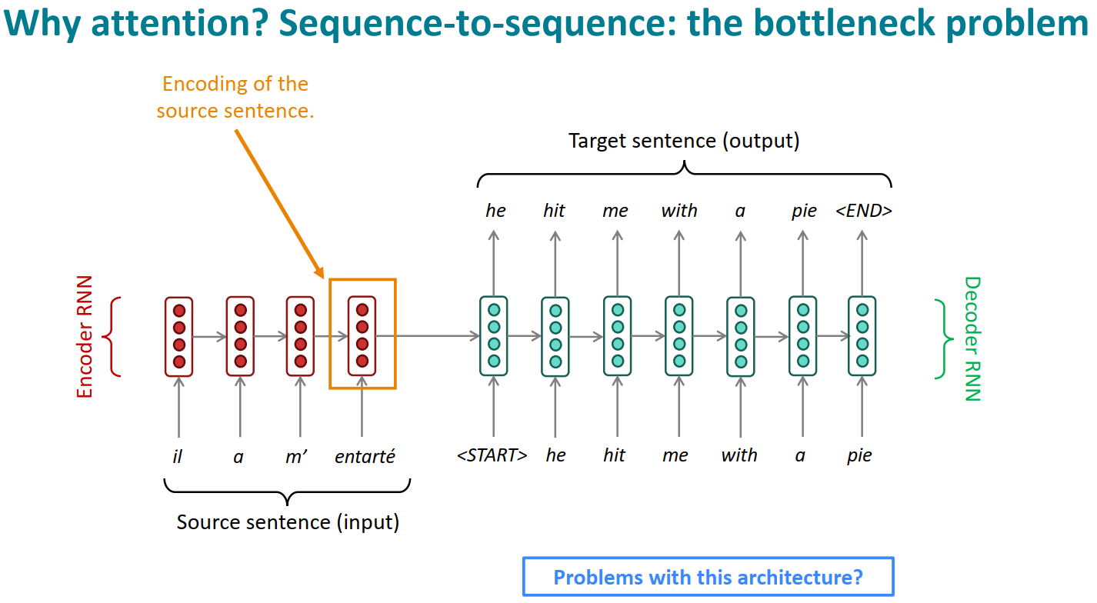
Transformers

Slide 33
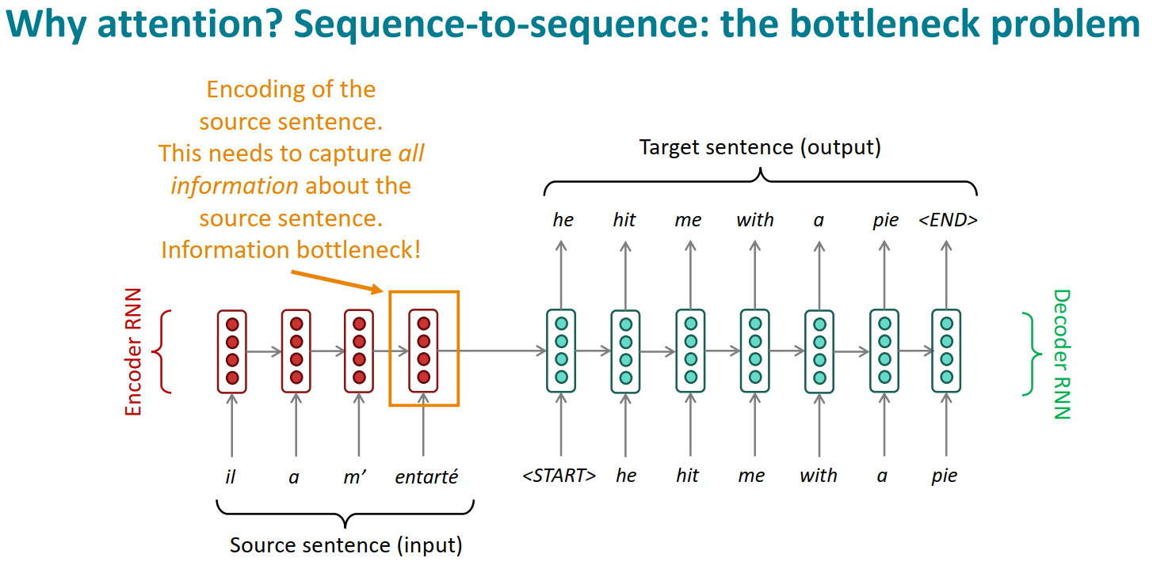
Transformers

Slide 34
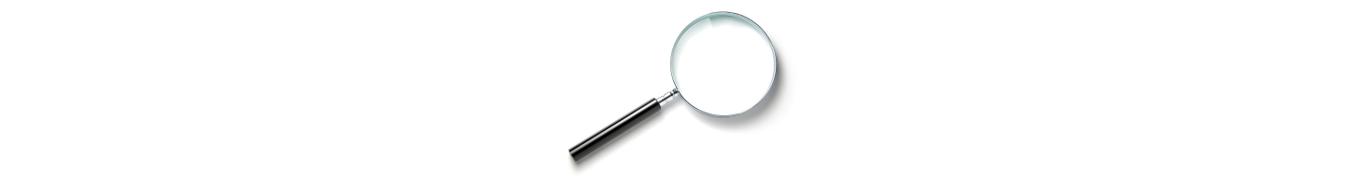
Transformers
Attention
• Attention provides a solution to the bottleneck problem.
• Core idea: on each step of the decoder, use direct connection to the encoder to focus on a particular part of the source sequence
• First, we will show via diagram (no equations), then we will show with equations

Slide 35
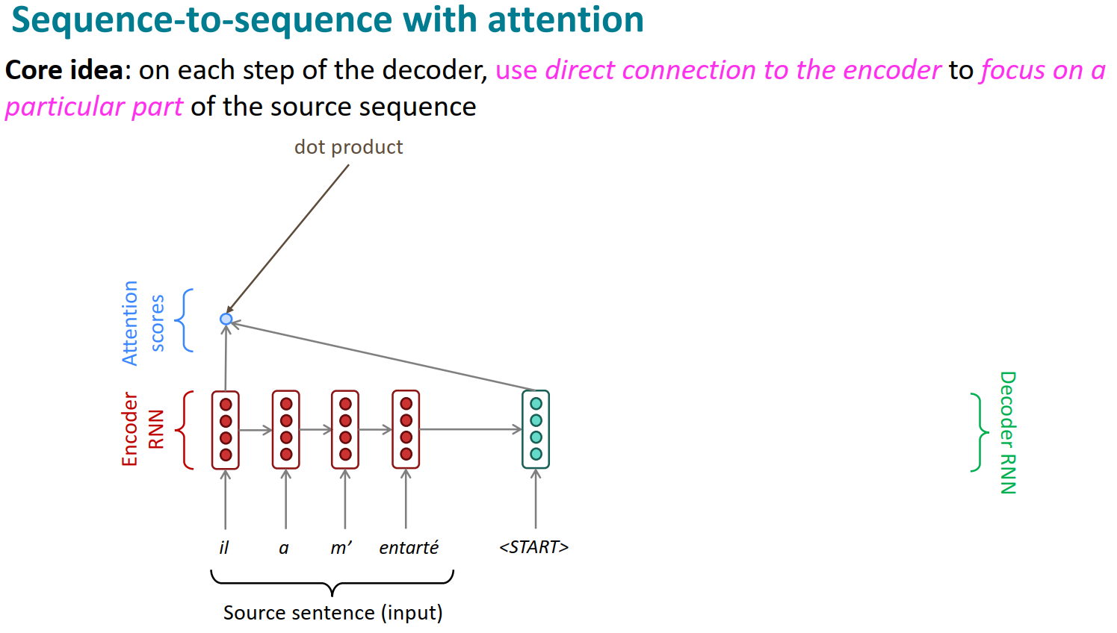
Transformers

Slide 36
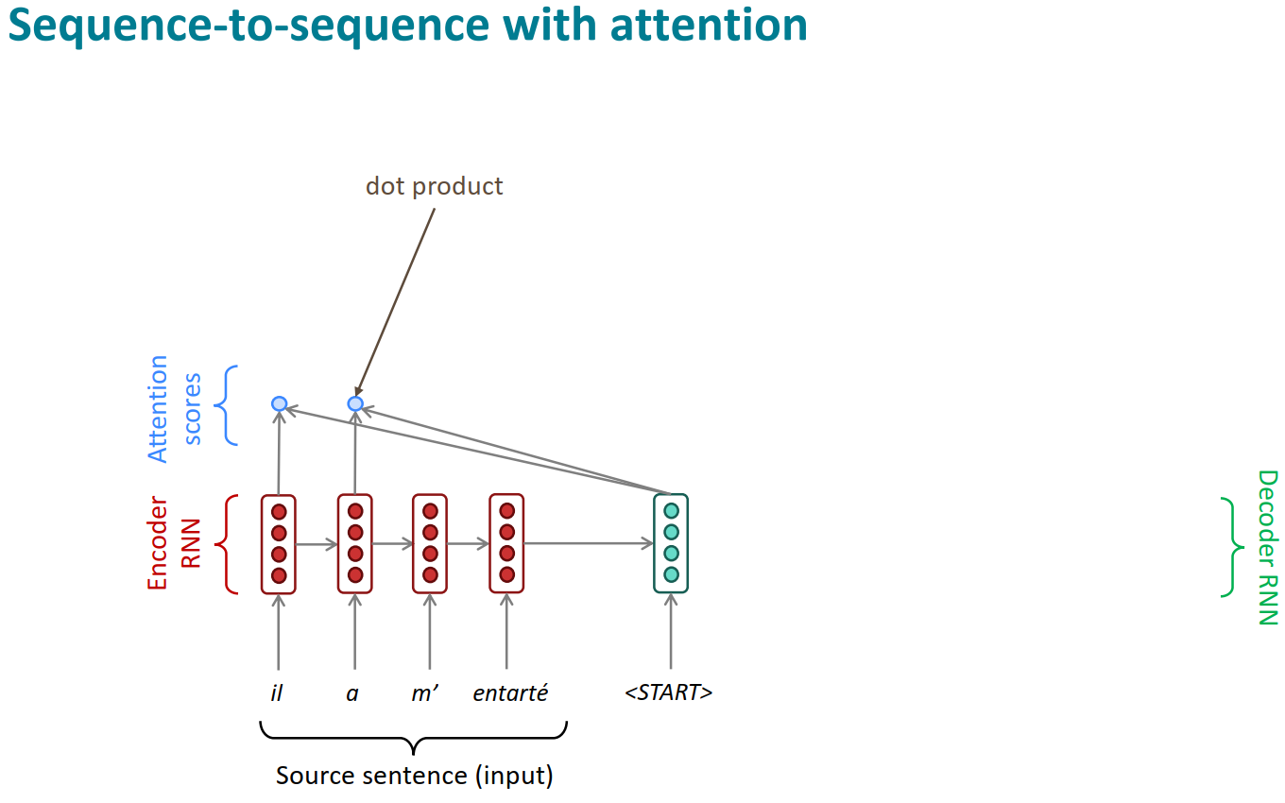
Transformers

Slide 37

Transformers

Slide 38
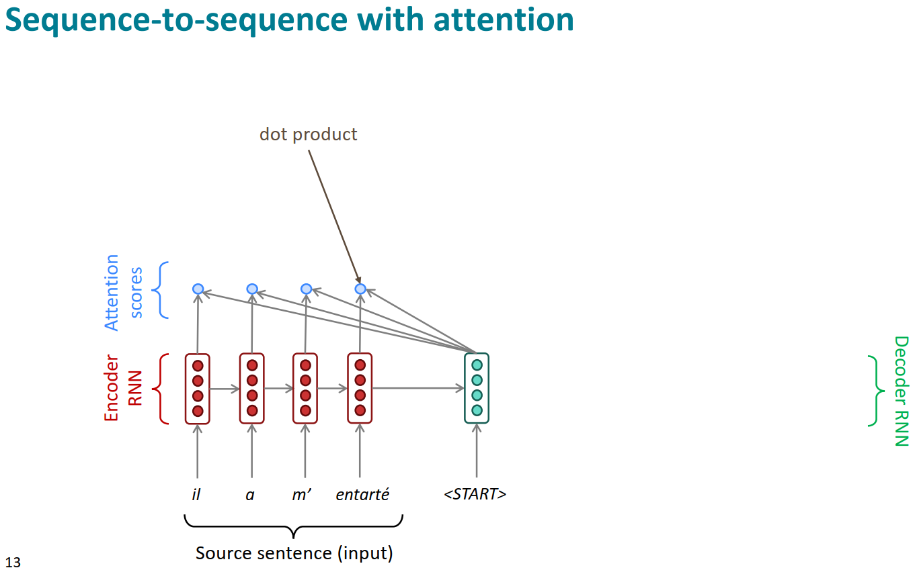
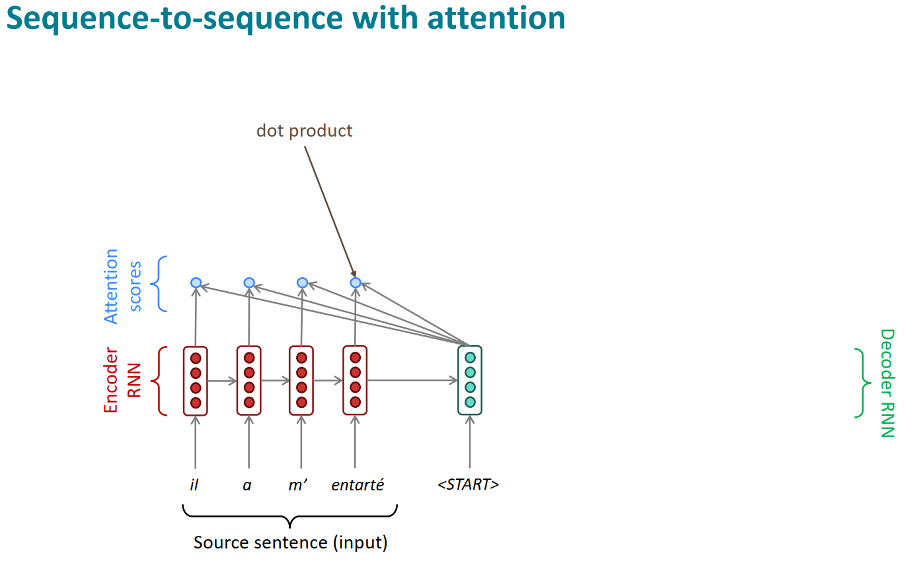
Transformers

Slide 39
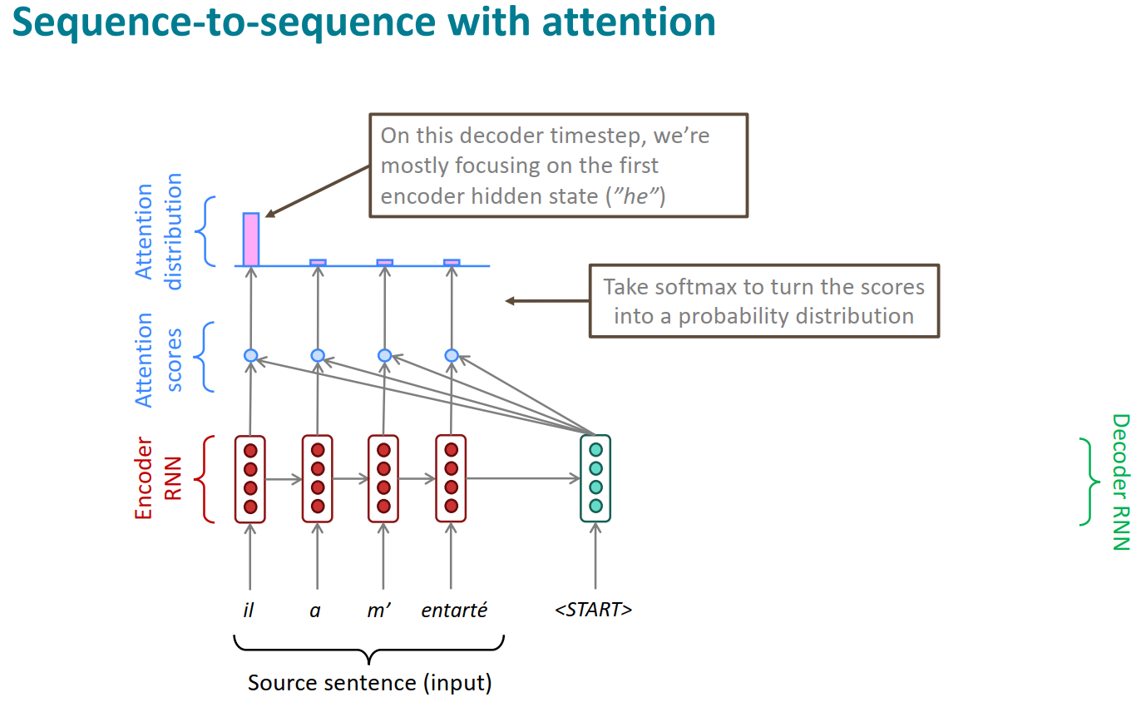
Transformers

Slide 40
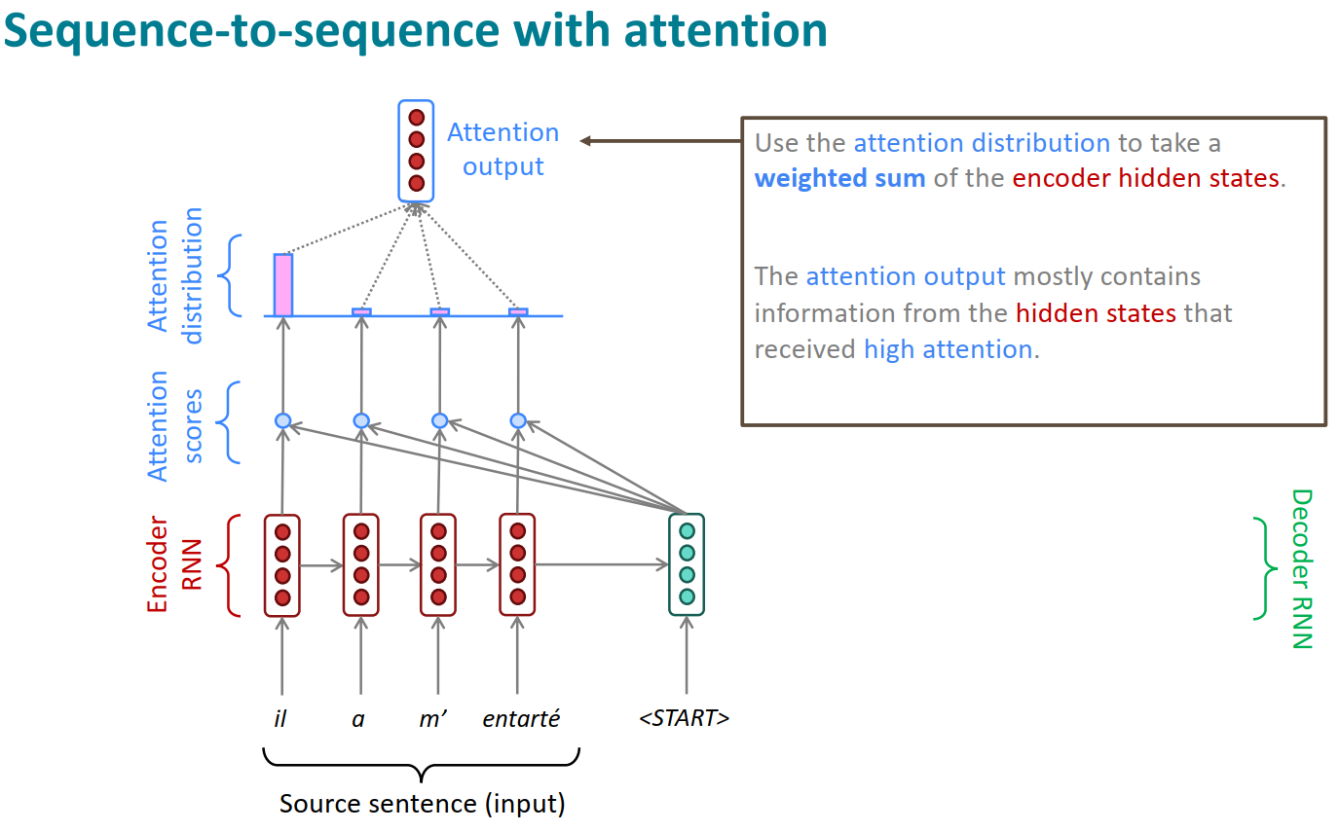
Transformers

Slide 41
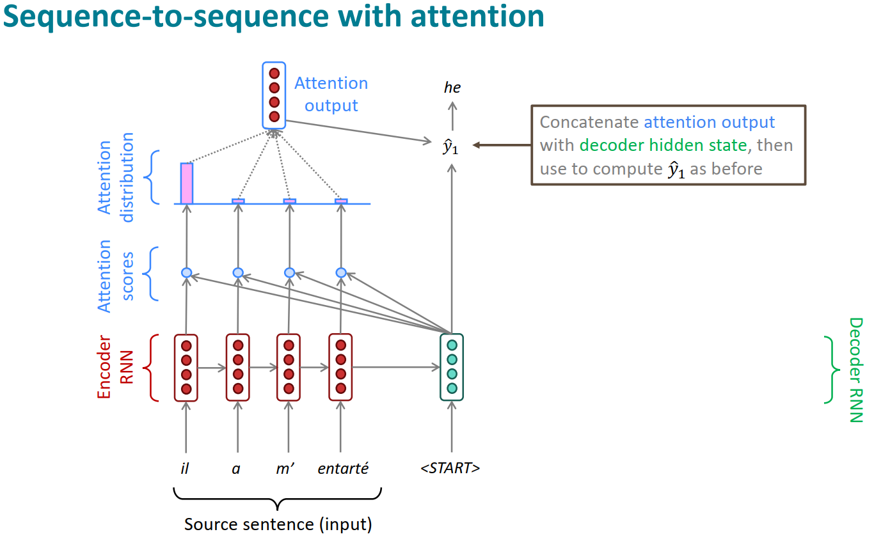
Transformers

Slide 42
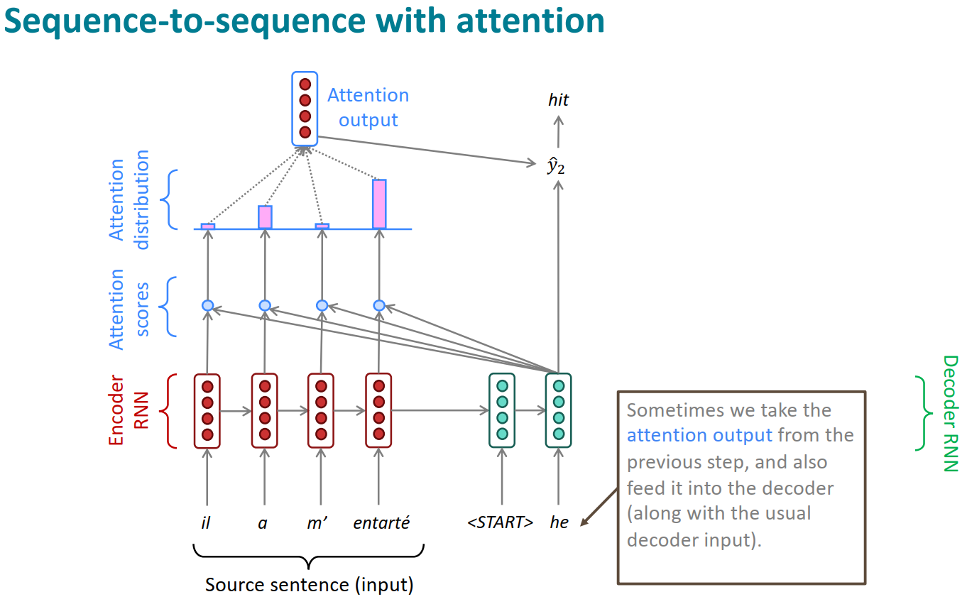
Transformers

Slide 43
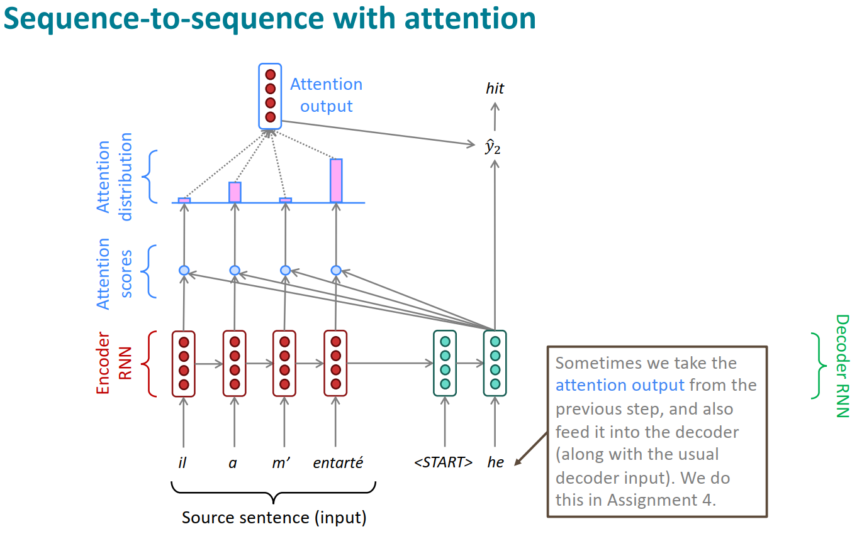
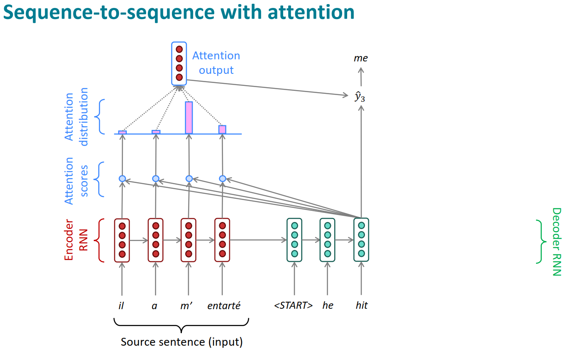
Transformers

Slide 44
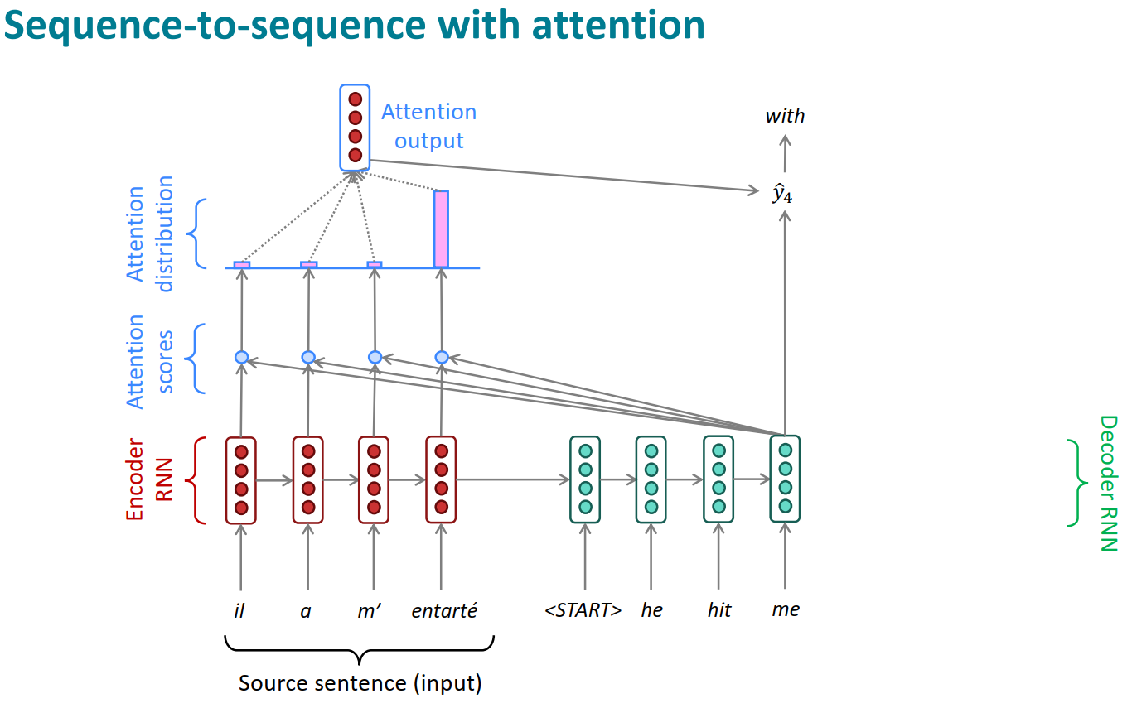
Transformers

Slide 45
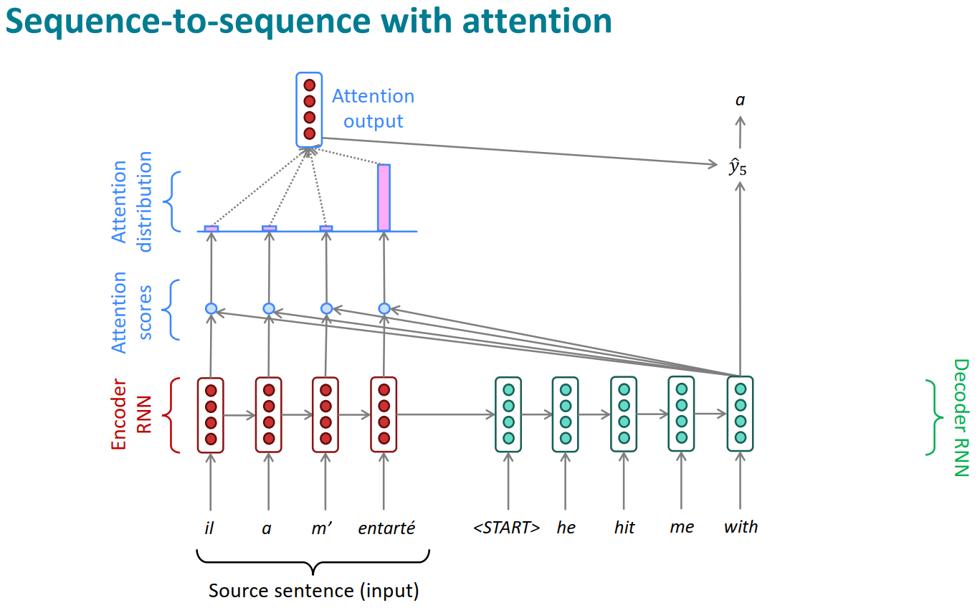
Transformers

Slide 46
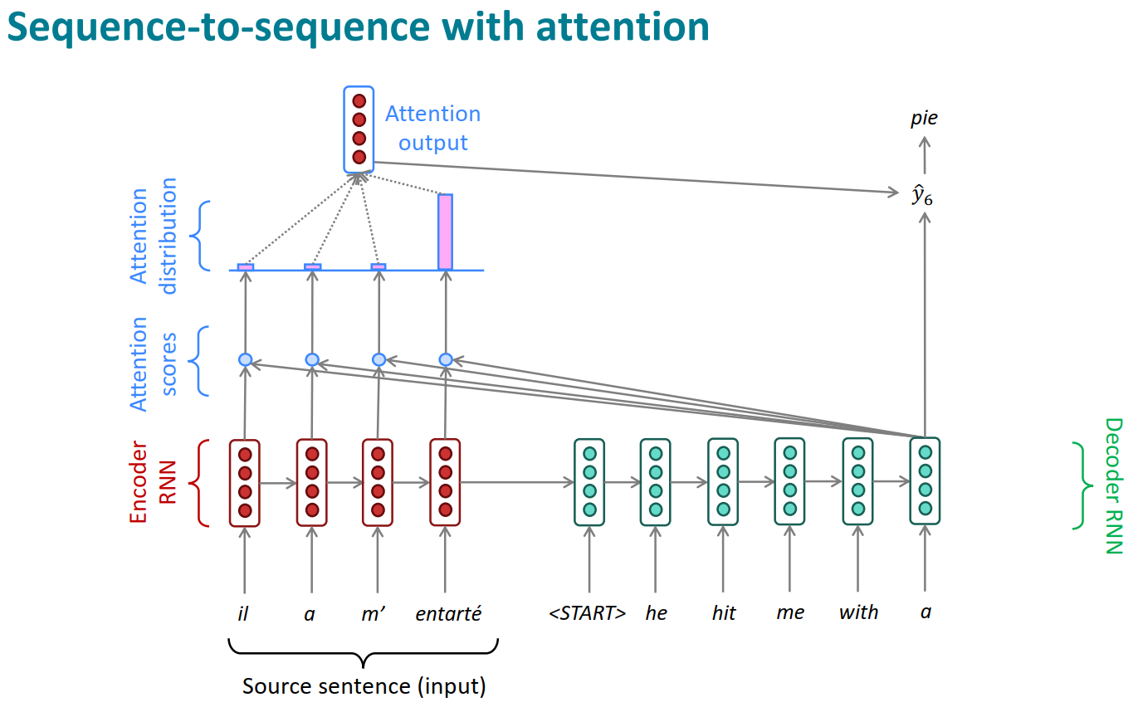
Transformers

Slide 47
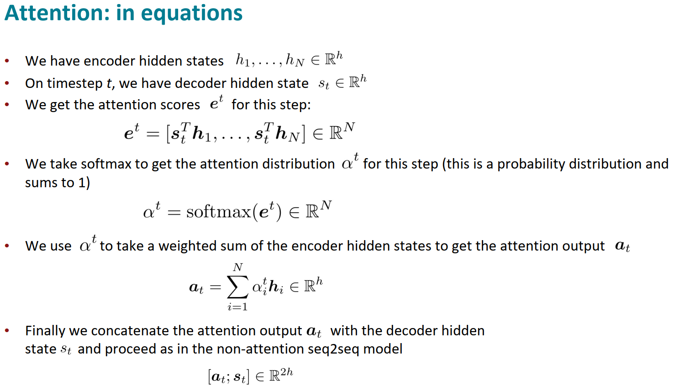
Transformers

Slide 48
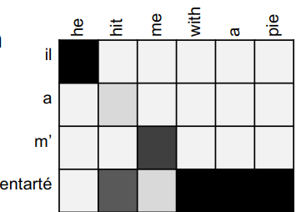
Transformers
Attention is great! • Attention significantly improves NMT performance • It’s very useful to allow decoder to focus on certain parts of the source • Attention provides a more “human-like” model of the MT process • You can look back at the source sentence while translating, rather than needing to remember it all • Attention solves the bottleneck problem • Attention allows decoder to look directly at source; bypass bottleneck • Attention helps with the vanishing gradient problem • Provides shortcut to faraway states • Attention provides some interpretability • By inspecting attention distribution, we see what the decoder was focusing on • We get (soft) alignment for free! • This is cool because we never explicitly trained an alignment system • The network just learned alignment by itself

Slide 49
Transformers
Attention is a general Deep Learning technique • We’ve seen that attention is a great way to improve the sequence-to-sequence model for Machine Translation. • However: You can use attention in many architectures (not just seq2seq) and many tasks (not just MT)
• More general definition of attention: • Given a set of vector values, and a vector query, attention is a technique to compute a weighted sum of the values, dependent on the query.
• We sometimes say that the query attends to the values. • For example, in the seq2seq + attention model, each decoder hidden state (query) attends to all the encoder hidden states (values).

Slide 50
Transformers
Attention is a general Deep Learning technique
• More general definition of attention: • Given a set of vector values, and a vector query, attention is a technique to compute a weighted sum of the values, dependent on the query.
Intuition: • The weighted sum is a selective summary of the information contained in the values, where the query determines which values to focus on. • Attention is a way to obtain a fixed-size representation of an arbitrary set of representations (the values), dependent on some other representation (the query).
Upshot: • Attention has become the powerful, flexible, general way pointer and memory manipulation in all deep learning models. A new idea from after 2010! From NMT!

Slide 51
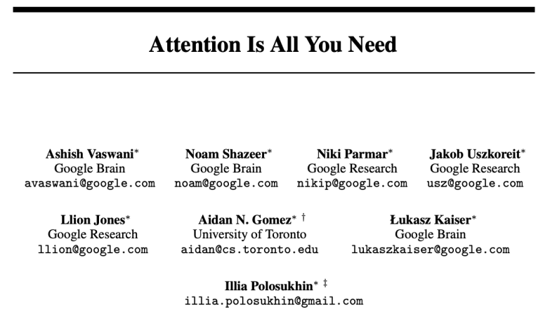
Transformers
Transformers: Is Attention All We Need?
• We learned that attention dramatically improves the performance of recurrent neural networks.
• Today, we will take this one step further and ask Is Attention All We Need? • Spoiler: Not Quite!

Slide 52
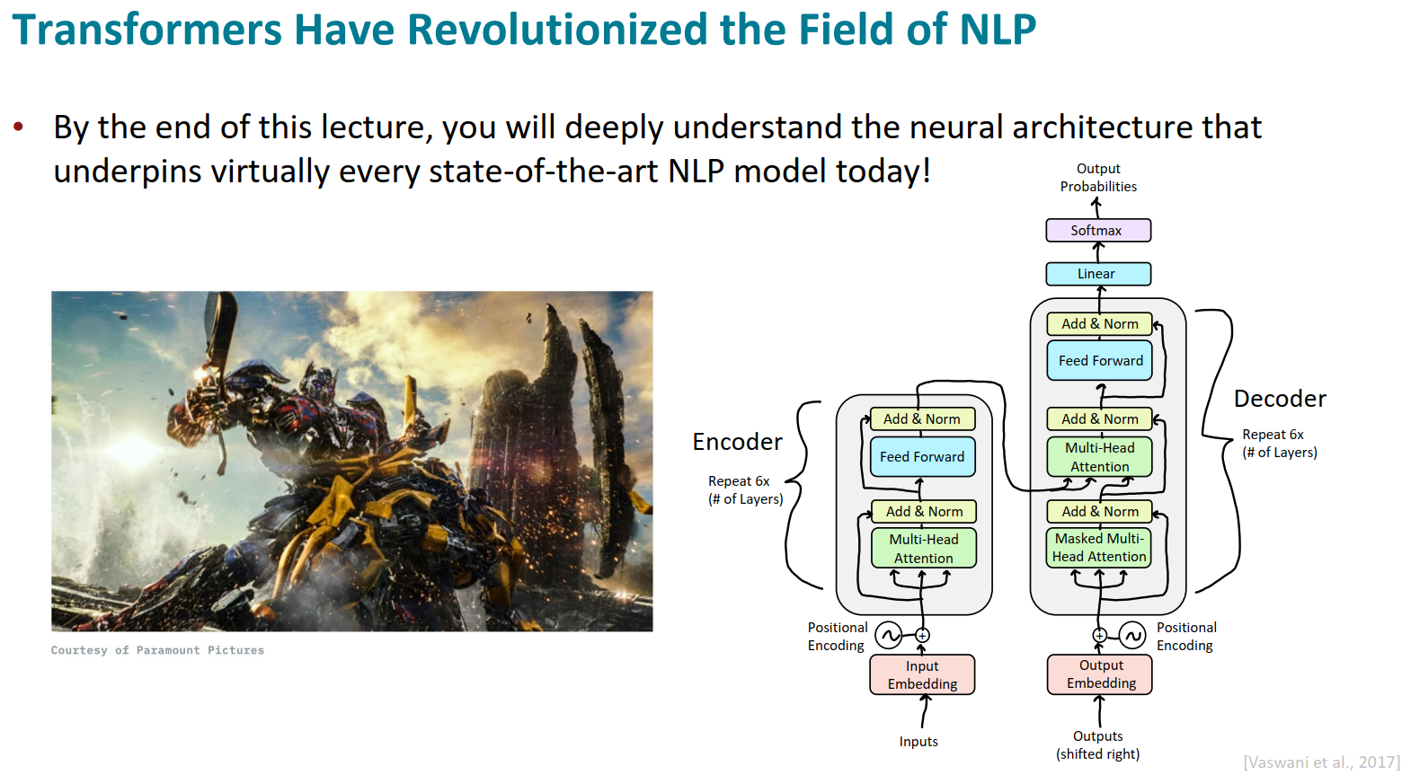
Transformers

Slide 53
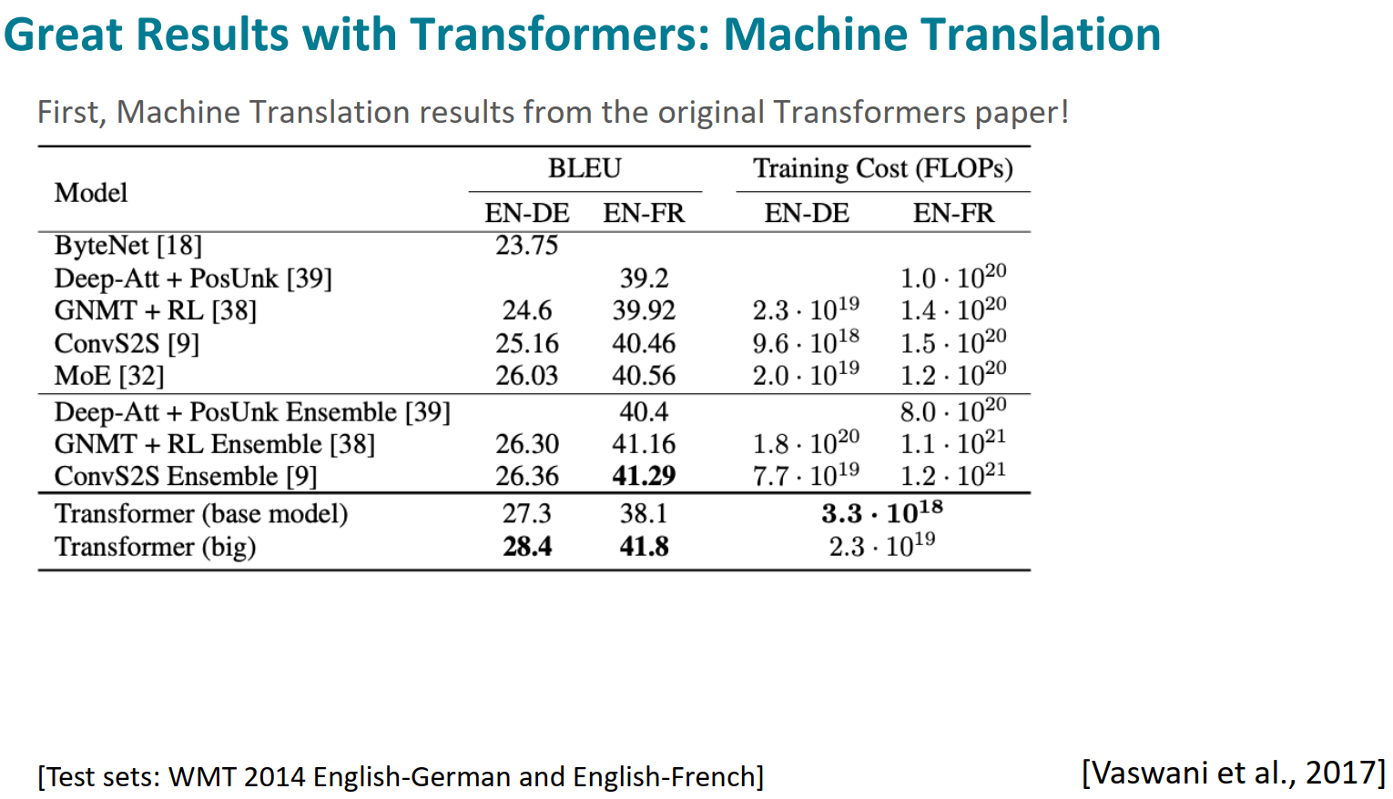
Transformers

Slide 54
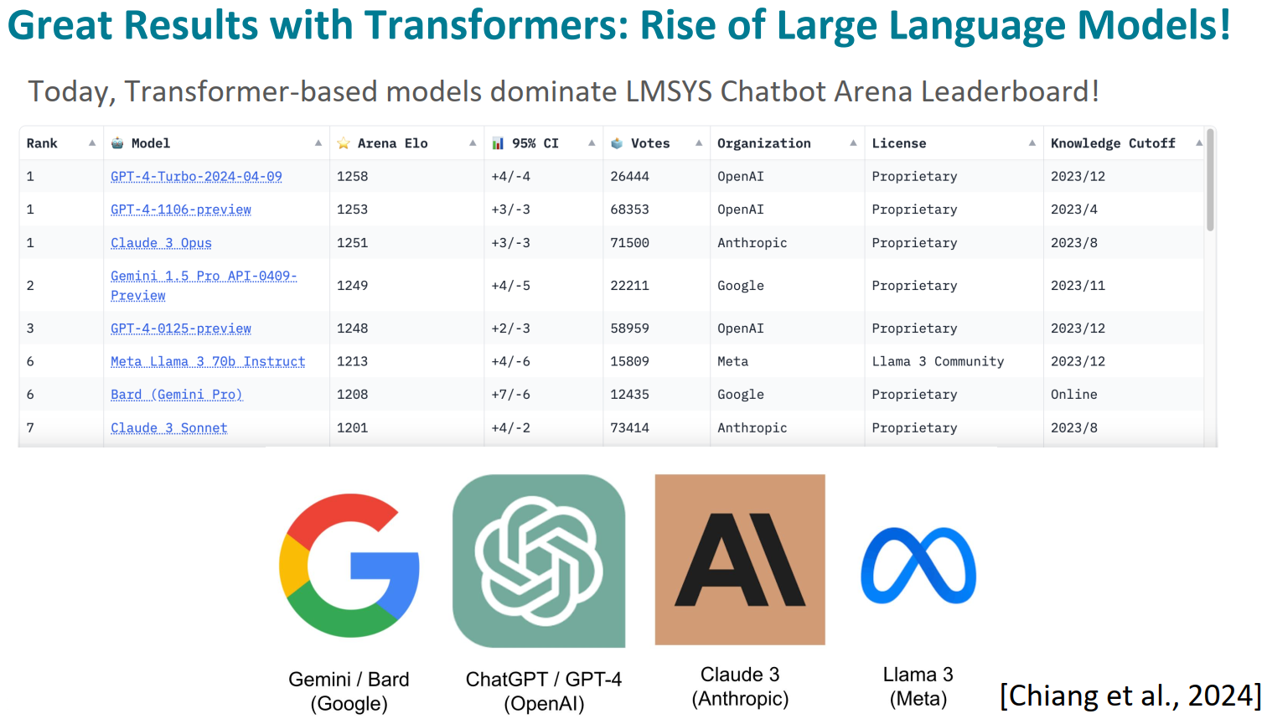
Transformers

Slide 55
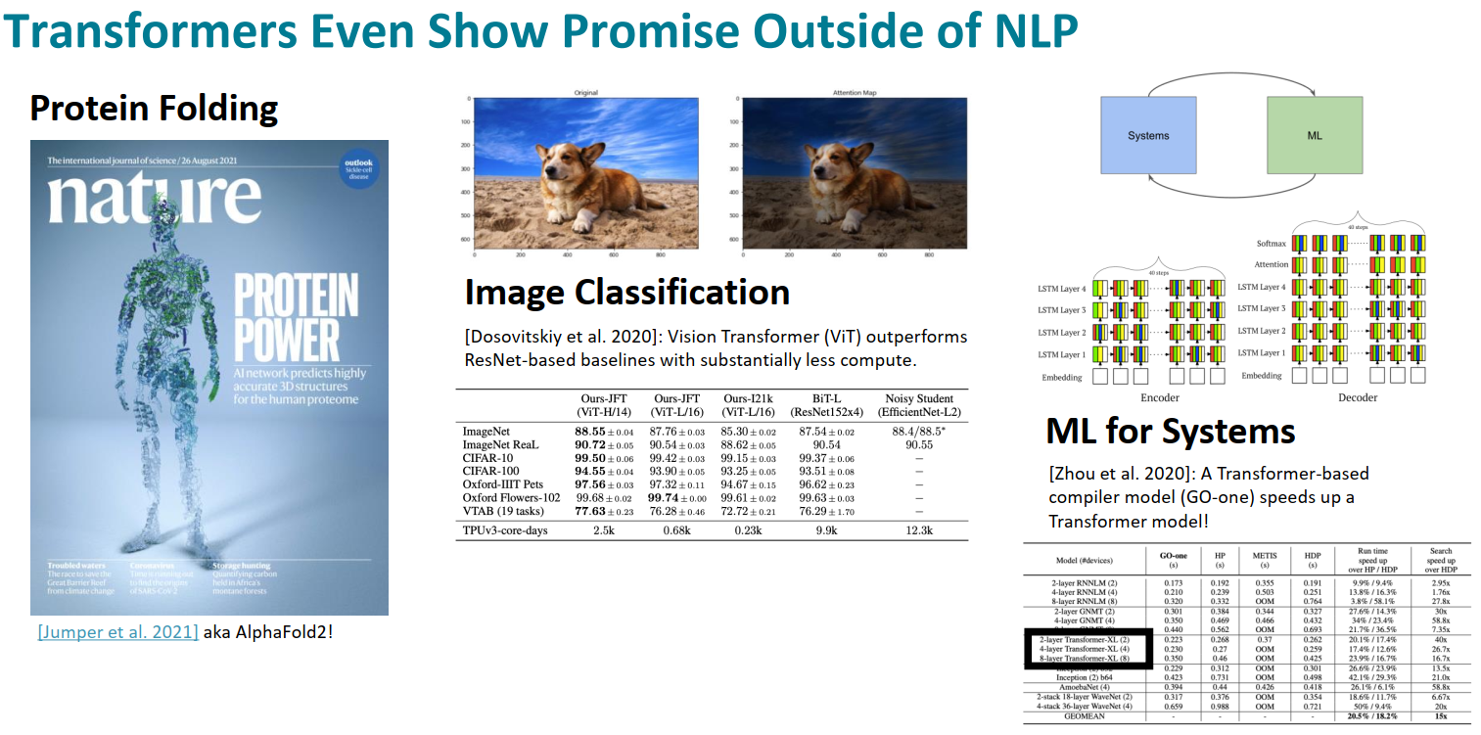
Transformers

Slide 56
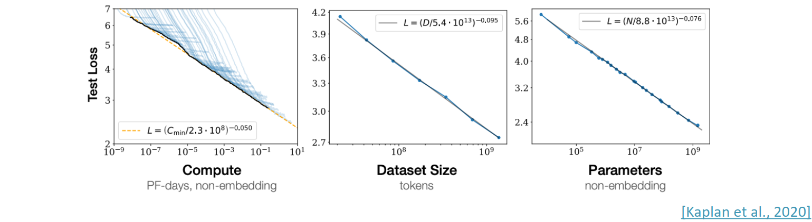
Transformers
Scaling Laws: Are Transformers All We Need? • With Transformers, language modeling performance improves smoothly as we increase model size, training data, and compute resources in tandem. • This power-law relationship has been observed over multiple orders of magnitude with no sign of slowing! • If we keep scaling up these models (with no change to the architecture), could they eventually match or exceed human-level performance?

Slide 57
Transformers
Why Move Beyond Recurrence? Motivation for Transformer Architecture The Transformers authors had 3 desirata when designing this architecture: 1. Minimize (or at least not increase) computational complexity per layer. 2. Minimize path length between any pair of words to facilitate learning of long-range dependencies. 3. Maximize the amount of computation that can be parallelized.

Slide 58
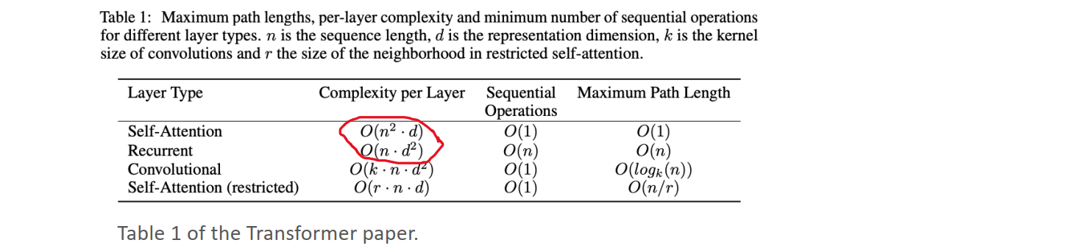
Transformers
1. Transformer Motivation: Computational Complexity Per Layer When sequence length (n) << representation dimension (d), complexity per layer is lower for a Transformer compared to the recurrent models we’ve learned about so far.

Slide 59
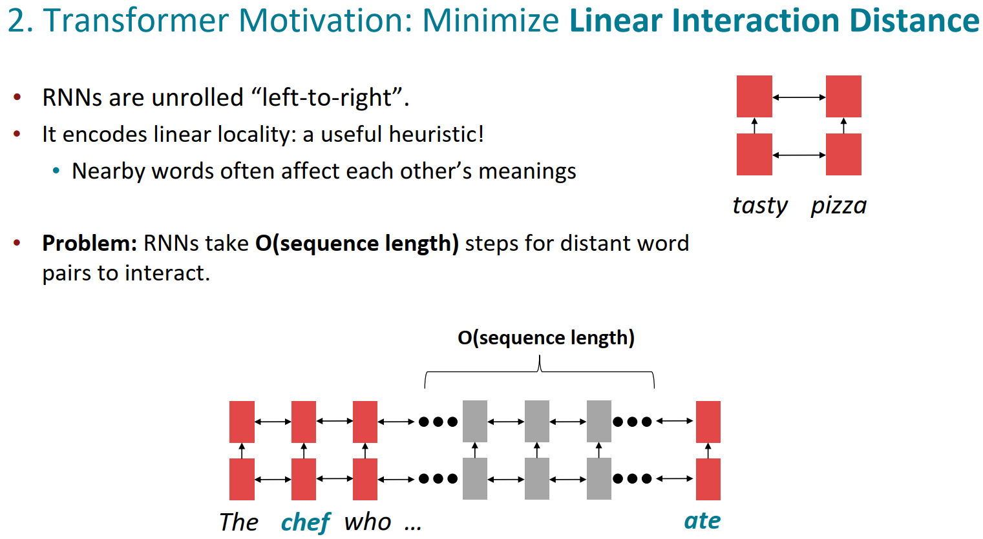
Transformers
2. Transformer Motivation: Minimize Linear Interaction Distance
• RNNs are unrolled “left-to-right”. • It encodes linear locality: a useful heuristic! • Nearby words often affect each other’s meanings
• Problem: RNNs take O(sequence length) steps for distant word pairs to interact.

Slide 60
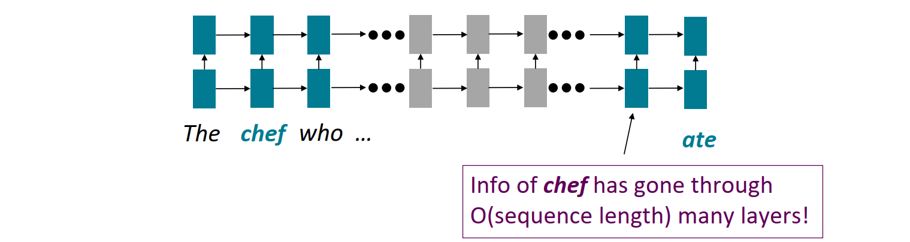
Transformers
2. Transformer Motivation: Minimize Linear Interaction Distance
• O(sequence length) steps for distant word pairs to interact means: • Hard to learn long-distance dependencies (because gradient problems!) • Linear order of words is “baked in”; we already know sequential structure doesn't tell the whole story...

Slide 61
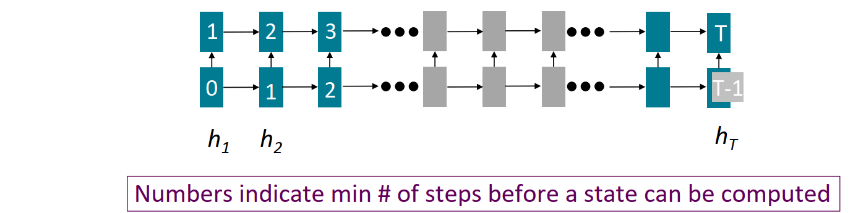
Transformers
3. Transformer Motivation: Maximize Parallelizability
• Forward and backward passes have O(seq length) unparallelizable operations • GPUs (and TPUs) can perform many independent computations at once! • But future RNN hidden states can’t be computed in full before past RNN hidden states have been computed • Inhibits training on very large datasets! • Particularly problematic as sequence length increases, as we can no longer batch many examples together due to memory limitations

Slide 62
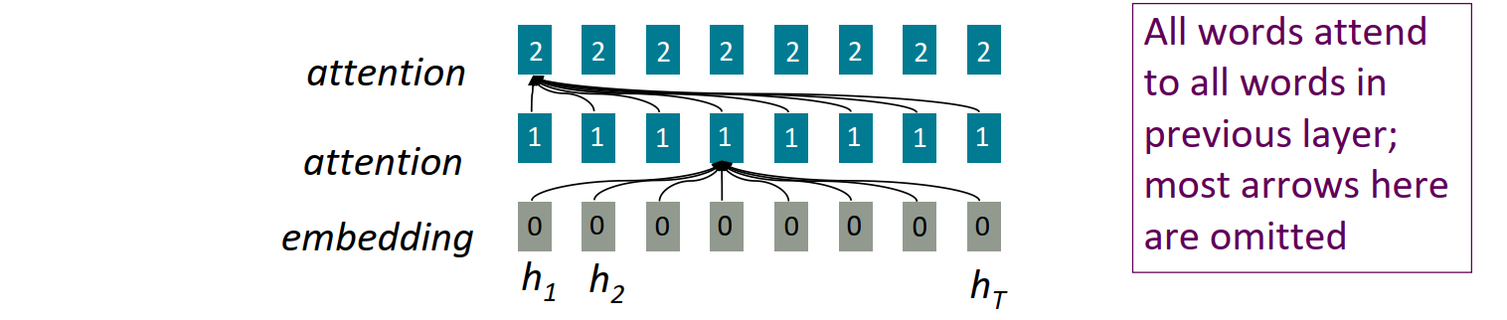
Transformers
High-Level Architecture: Transformer is all about (Self) Attention
• To recap, attention treats each word’s representation as a query to access and incorporate information from a set of values. • Previously, we saw attention from the decoder to the encoder in a recurrent sequence-to-sequence model • Self-attention is encoder-encoder (or decoder-decoder) attention where each word attends to each other word within the input (or output)

Slide 63
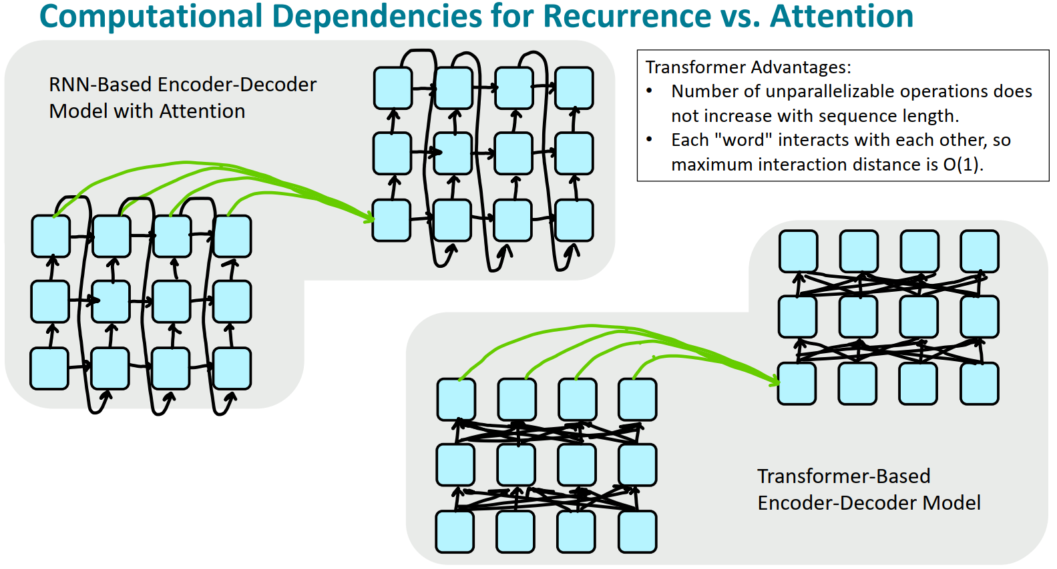
Transformers

Slide 64

Transformers

Slide 65

Transformers
Encoder: Self-Attention

Slide 66

Transformers
Intuition for Attention Mechanism ▪ Let's think of attention as a "fuzzy" or approximate hashtable: ▪ To look up a value, we compare a query against keys in a table. ▪ In a hashtable (shown on the bottom left): ▪ Each query (hash) maps to exactly one key-value pair. ▪ In (self-)attention (shown on the bottom right): ▪ Each query matches each key to varying degrees. ▪ We return a sum of values weighted by the query-key match.

Slide 67

Transformers

Slide 68

Transformers

Slide 69

Transformers

Slide 70

Transformers
But attention isn't quite all you need! • Problem: Since there are no element-wise non-linearities, selfattention is simply performing a re-averaging of the value vectors. • Easy fix: Apply a feedforward layer to the output of attention, providing non-linear activation (and additional expressive power).

Slide 71

Transformers
But how do we make this work for deep networks?

Slide 72

Transformers

Slide 73

Transformers

Slide 74

Transformers

Slide 75

Transformers
Major issue! • We're almost done with the Encoder, but we have a major problem! Has anyone spotted it? • Consider this sentence: • "Man eats small dinosaur." • Wait a minute, order doesn't impact the network at all! • This seems wrong given that word order does have meaning in many languages, including English!

Slide 76

Transformers
Solution: Inject Order Information through Positional Encodings!

Slide 77

Transformers
Fixing the first self-attention problem: sequence order
• Since self-attention doesn’t build in order information, we need to encode the order of the sentence in our keys, queries, and values. • Consider representing each sequence index as a vector

Slide 78

Transformers
Position representation vectors through sinusoids (original)
• Sinusoidal position representations: concatenate sinusoidal functions of varying periods:
• Pros: • Periodicity indicates that maybe “absolute position” isn’t as important • Maybe can extrapolate to longer sequences as periods restart • Cons: • Not learnable; also the extrapolation doesn’t really work

Slide 79

Transformers
Extension: Self-Attention w/ Relative Position Encodings
Key Insight: The most salient position information is the relationship (e.g. “cat” is the word before “eat”) between words, rather than their absolute position (e.g. “cat” is word 2).
Table and Equations From [Shaw et al., 2018]

Slide 80

Transformers
Multi-Headed Self-Attention: k heads are better than 1! • High-Level Idea: Let's perform self-attention multiple times in parallel and combine the results.

Slide 81

Transformers
The Transformer Encoder: Multi-headed Self-Attention • What if we want to look in multiple places in the sentence at once? • For word 𝑖, self-attention “looks” where 𝑥𝑖⊤𝑄⊤𝐾𝑥𝑗 is high, but maybe we want to focus on different 𝑗 for different reasons? • We’ll define multiple attention “heads” through multiple Q,K,V matrices • Let, 𝑄ℓ, 𝐾ℓ, 𝑉ℓ ∈ ℝ𝑑×𝑑 ℎ, where ℎ is the number of attention heads, and ℓ ranges from 1 to ℎ. • Each attention head performs attention independently: • outputℓ = softmax 𝑋𝑄ℓ𝐾ℓ⊤𝑋⊤ ∗ 𝑋𝑉ℓ, where outputℓ ∈ ℝ𝑑/ℎ • Then the outputs of all the heads are combined! • output = 𝑌[output1; … ; outputℎ], where 𝑌 ∈ ℝ𝑑×𝑑
• Each head gets to “look” at different things, and construct value vectors differently.

Slide 82

Transformers

Slide 83

Transformers
Decoder: Masked Multi-Head Self-Attention • Problem: How do we keep the decoder from “cheating”? If we have a language modeling objective, can't the network just look ahead and "see" the answer?
• Solution: Masked Multi-Head Attention. At a high-level, we hide (mask) information about future tokens from the model.

Slide 84

Transformers

Slide 85

Transformers

Slide 86

Transformers

Slide 87

Transformers
Decoder: Finishing touches! • Add a feed forward layer (with residual connections and layer norm)

Slide 88

Transformers
Decoder: Finishing touches! • Add a feed forward layer (with residual connections and layer norm)
• Add a final linear layer to project the embeddings into a much longer vector of length vocab size (logits)

Slide 89

Transformers
Decoder: Finishing touches! • Add a feed forward layer (with residual connections and layer norm)
• Add a final linear layer to project the embeddings into a much longer vector of length vocab size (logits)
• Add a final softmax to generate a probability distribution of possible next words!

Slide 90

Transformers

Slide 91
目录
第8章 Intro to NLP
1 Word2Vec
2 Seq2Seq Models
3 Transformers
4 LLMs

Slide 92

LLMs

Slide 93

LLMs
Pretraining – scaling unsupervised learning on the internet
Key ideas in pretraining • Make sure your model can process large-scale, diverse datasets • Don’t use labeled data (otherwise you can’t scale!) • Compute-aware scaling

Slide 94
LLMs
Motivating word meaning and context
Recall the adage we mentioned at the beginning of the course:
“You shall know a word by the company it keeps” (J. R. Firth 1957: 11)
This quote is a summary of distributional semantics, and motivated word2vec. But:
“… the complete meaning of a word is always contextual, and no study of meaning apart from a complete context can be taken seriously.” (J. R. Firth 1935)
Consider I record the record: the two instances of record mean different things.

Slide 95

LLMs
Where we were: pretrained word embeddings
Circa 2015: • Start with pretrained word embeddings (no context!) • Learn how to incorporate context in an LSTM or Transformer while training on the task.
Some issues to think about: • The training data we have for our downstream task (like question answering) must be sufficient to teach all contextual aspects of language. • Most of the parameters in our network are randomly initialized!

Slide 96

LLMs
Where we’re going: pretraining whole models
In modern NLP: • All (or almost all) parameters in NLP networks are initialized via pretraining. • Pretraining methods hide parts of the input from the model, and train the model to reconstruct those parts. • This has been exceptionally effective at building strong: • representations of language • parameter initializations for strong NLP models. • Probability distributions over language that we can sample from 15

Slide 97

LLMs
Pretraining through language modeling
[Dai and Le, 2015]
Recall the language modeling task: • Model , the probability distribution over words given their past contexts. • There’s lots of data for this! (In English.)
Pretraining through language modeling: • Train a neural network to perform language modeling on a large amount of text. • Save the network parameters.

Slide 98

LLMs
The Pretraining / Finetuning Paradigm
Pretraining can improve NLP applications by serving as parameter initialization.

Slide 99

LLMs
Stochastic gradient descent and pretrain/finetune
Why should pretraining and finetuning help, from a “training neural nets” perspective?

Slide 100

LLMs

Slide 101

LLMs

Slide 102

LLMs

Slide 103

LLMs
retraining for three types of architectures
The neural architecture influences the type of pretraining, and natural use cases.

Slide 104

LLMs
retraining for three types of architectures
The neural architecture influences the type of pretraining, and natural use cases.

Slide 105

LLMs
Pretraining encoders: what pretraining objective to use?
So far, we’ve looked at language model pretraining. But encoders get bidirectional context, so we can’t do language modeling! Idea: replace some fraction of words in the input with a special [MASK] token; predict these words

Slide 106

LLMs
BERT: Bidirectional Encoder Representations from Transformers
Devlin et al., 2018 proposed the “Masked LM” objective and released the weights of a pretrained Transformer, a model they labeled BERT. Some more details about Masked LM for BERT: • Predict a random 15% of (sub)word tokens. • Replace input word with [MASK] 80% of the time • Replace input word with a random token 10% of the time • Leave input word unchanged 10% of the time (but still predict it!) • Why? Doesn’t let the model get complacent and not build strong representations of non-masked words. (No masks are seen at fine-tuning time!)
[Devlin et al., 2018]

Slide 107

LLMs
BERT: Bidirectional Encoder Representations from Transformers • The pretraining input to BERT was two separate contiguous chunks of text:
• BERT was trained to predict whether one chunk follows the other or is randomly sampled. • Later work has argued this “next sentence prediction” is not necessary.

Slide 108

LLMs
Limitations of pretrained encoders
Those results looked great! Why not use pretrained encoders for everything? If your task involves generating sequences, consider using a pretrained decoder; BERT and other pretrained encoders don’t naturally lead to nice autoregressive (1-word-at-a-time) generation methods.

Slide 109

LLMs

Slide 110

LLMs

Slide 111

LLMs
Pretraining encoder-decoders: what pretraining objective to use?
What Raffel et al., 2018 found to work best was span corruption.
Their model: T5.

Slide 112

LLMs
Pretraining encoder-decoders: what pretraining objective to use?
A fascinating property of T5: it can be finetuned to answer a wide range of questions, retrieving knowledge from its parameters.
NQ: Natural Questions WQ: WebQuestions TQA: Trivia QA
All “open-domain” versions

Slide 113

LLMs

Slide 114

LLMs

Slide 115

LLMs

Slide 116
LLMs
Generative Pretrained Transformer (GPT) [Radford et al., 2018]
2018’s GPT was a big success in pretraining a decoder! • Transformer decoder with 12 layers, 117M parameters. • 768-dimensional hidden states, 3072-dimensional feed-forward hidden layers. • Byte-pair encoding with 40,000 merges • Trained on BooksCorpus: over 7000 unique books. • Contains long spans of contiguous text, for learning long-distance dependencies. • The acronym “GPT” never showed up in the original paper; it could stand for “Generative PreTraining” or “Generative Pretrained Transformer”

Slide 117

LLMs
Generative Pretrained Transformer (GPT) [Radford et al., 2018]
How do we format inputs to our decoder for finetuning tasks?
Natural Language Inference: Label pairs of sentences as entailing/contradictory/neutral
Radford et al., 2018 evaluate on natural language inference. Here’s roughly how the input was formatted, as a sequence of tokens for the decoder.
[START] The man is in the doorway [DELIM] The person is near the door [EXTRACT]
The linear classifier is applied to the representation of the [EXTRACT] token.

Slide 118

LLMs
Increasingly convincing generations (GPT2) [Radford et al., 2018]
We mentioned how pretrained decoders can be used in their capacities as language models. GPT-2, a larger version (1.5B) of GPT trained on more data, was shown to produce relatively convincing samples of natural language.

Slide 119
LLMs
GPT-3, In-context learning, and very large models
So far, we’ve interacted with pretrained models in two ways: • Sample from the distributions they define (maybe providing a prompt) • Fine-tune them on a task we care about and take their predictions.
Very large language models seem to perform some kind of learning without gradient steps simply from examples you provide within their contexts.
GPT-3 is the canonical example of this. The largest T5 model had 11 billion parameters. GPT-3 has 175 billion parameters.
ChatGPT/GPT-4/GPT-3.5 Turbo introduced a further instruction-tuning idea that we cover next lecture

Slide 120

LLMs
GPT-3, In-context learning, and very large models
Very large language models seem to perform some kind of learning without gradient steps simply from examples you provide within their contexts.
The in-context examples seem to specify the task to be performed, and the conditional distribution mocks performing the task to a certain extent. Input (prefix within a single Transformer decoder context):

Slide 121

LLMs
GPT-3, In-context learning, and very large models Very large language models seem to perform some kind of learning without gradient steps simply from examples you provide within their contexts

Slide 122

LLMs
• Empirical observation: scaling up models leads to reliable gains in perplexity

Slide 123

LLMs
• Modern observation: train a big model that’s not fully converged.

Slide 124

LLMs
• Predictable scaling helps us make intelligent decisions about architectures etc.

Slide 125

LLMs

Slide 126

LLMs

Slide 127

LLMs
Language Models as Agent Models [Andreas, 2022]

Slide 128

LLMs

Slide 129

LLMs

Slide 130

LLMs
Emergent few-shot learning
• Specify a task by simply prepending examples of the task before your example • Also called in-context learning, to stress that no gradient updates are performed when learning a new task (there is a separate literature on few-shot learning with gradient updates)

Slide 131

LLMs

Slide 132

LLMs

Slide 133

LLMs

Slide 134

LLMs
[Brown et al., 2020] Language models are few-shot learners

Slide 135

LLMs

Slide 136

LLMs
Limits of prompting for harder tasks?
Some tasks seem too hard for even large LMs to learn through prompting alone. Especially tasks involving richer, multi-step reasoning. (Humans struggle at these tasks too!)

Slide 137

LLMs
[Wei et al., 2022; also see Nye et al., 2021]

Slide 138

LLMs

Slide 139

LLMs

Slide 140

LLMs

Slide 141

LLMs

Slide 142

LLMs

Slide 143

LLMs
Recap: The Pretraining / Finetuning Paradigm
Pretraining can improve NLP applications by serving as parameter initialization.

Slide 144

LLMs
Recap: The Pretraining / Finetuning Paradigm
Pretraining can improve NLP applications by serving as parameter initialization.

Slide 145

LLMs
[FLAN-T5; Chung et al., 2022]

Slide 146

LLMs

Slide 147

LLMs

Slide 148

LLMs
Limitations of instruction finetuning? • One limitation of instruction finetuning is obvious: it’s expensive to collect groundtruth data for
tasks. Can you think of other subtler limitations? • Problem 1: tasks like open-ended creative generation have no right answer. • Write me a story about a dog and her pet grasshopper. • Problem 2: language modeling penalizes all token-level mistakes equally, but some errors are worse than others. • Problem 3: humans generate suboptimal answers • Even with instruction finetuning, there a mismatch between the LM objective and the objective of “satisfy human preferences”! • Can we explicitly attempt to satisfy human preferences?

Slide 149

LLMs

Slide 150

LLMs
• First step: instruction tuning! • Second + third steps: maximize reward (but how??)

Slide 151

LLMs
How do we get the rewards? • Problem 1: human-in-the-loop is expensive! • Solution: instead of directly asking humans for preferences, model their preferences as a separate (NLP) problem!
[Knox and Stone, 2009]

Slide 152

LLMs
How do we model human preferences? • Problem 2: human judgments are noisy and miscalibrated! • Solution: instead of asking for direct ratings, ask for pairwise comparisons, which can be more reliable

Slide 153

LLMs
How do we model human preferences? • Problem 2: human judgments are noisy and miscalibrated! • Solution: instead of asking for direct ratings, ask for pairwise comparisons, which can be more reliable

Slide 154

LLMs

Slide 155

LLMs

Slide 156

LLMs
How to optimize? Reinforcement Learning! • The field of reinforcement learning (RL) has studied these (and related) problems for many years now [Williams, 1992; Sutton and Barto, 1998] • Circa 2013: resurgence of interest in RL applied to deep learning, game-playing [Mnih et al., 2013] • But the interest in applying RL to modern LMs is an even newer phenomenon [Ziegler et al., 2019; Stiennon et al., 2020; Ouyang et al., 2022] . General Idea:

Slide 157

LLMs

Slide 158

LLMs
https://openai.com/blog/chatgpt/

Slide 159

LLMs
https://openai.com/blog/chatgpt/

Slide 160

LLMs
What’s next?
• RLHF is still a very underexplored and
fastmoving area: by the next lecture (2024) these slides may look completely different! • RLHF is (still!) data expensive. Recent work aims to alleviate such data requirements: • RL from AI feedback [Bai et al., 2022] • Finetuning LMs on their own outputs [Huang et al., 2022; Zelikman et al., 2022] • Personalizing language models • However, there are still many limitations of large LMs (size, hallucination) that may not be solvable with RLHF!
[Kirk et al., 2024]

Slide 161
LLMs
Thank you!

